Slide 1
WAY OR NO WAY
What do you really know about how
Americans spend and save their money?

Slide 2
LifeSmarts is a program of the National Consumers League

Slide 3
1-Way or No Way?
25% of Americans report they worry about money “all the time.”

Slide 4
1-NO WAY
According to a recent CNN survey, 71% of Americans identify money as a significant cause of stress in their lives.

Slide 5
2-Way or No Way?
A recent survey of parents of high school students revealed that 90% of parents agree that their teenagers think “money grows on trees.”

Slide 6
2-NO WAY
64% of teens report being grateful for what they have and over 55% report appreciating their parents’ hard work.
Many teenagers are in the work force and understand that money and hard work go together.
— Charles Schwab Teens & Money Survey

Slide 7
3-Way or No Way?
According to Fortune Magazine, the average prom can cost between $600 to $1000 or more.

Slide 8
3-WAY
The average teen now spends about $1,000 on prom, including an average of $325 on the “promposal,” (extreme spending when a teen asks a date to the dance).
— 2019, NBC12
Notes:
The Visa survey also found that parents are planning to pay for 59% of prom costs, while their
teens are covering the remaining 41%.

Slide 9
4-Way or No Way?
When dreaming about which car to buy, the most important factor for teens was the style or “cool factor.”

Slide 10
4-WAY
The most important factors for parents are safety and reliability.
Behavioral economists tell us that our buying decisions are not always rational but do follow patterns.
— autoextra.com

Slide 11
5-Way or No Way?
In 2022, the median earnings of those with a bachelor’s degree were 59 percent higher than the earnings of those who completed high school as their highest level of attainment.

Slide 12
5-WAY
As cited by the National Center of Education Statistics, each high school dropout cost the United States economy $272,000 due to “lower tax contributions, higher reliance on Medicaid and Medicare, higher rates of criminal activity, and higher reliance on welfare.”
Notes:
7000 high school students drop out of school every day.

Slide 13
6-Way or No Way?
19% of bankruptcies are filed by people under the age of 35.

Slide 14
6-WAY
Recent statistics provide insights into bankruptcy filings by age group. In 2022, individuals aged 18-29 accounted for 6,780 bankruptcies, while those aged 30-39 accounted for 47,140 filings. Combined, these totaled 53,920 filings. Given that the total number of bankruptcy filings across all age groups was 156,060 in 2022, individuals under 40 represented approximately 34.5% of all filings
“There is no short cut to any place worth going.”
— Beverly Sills

Slide 15
7-Way or No Way?
Four in five young adults are not financially independent but 75% consider it at top goal.”.

Slide 16
7-WAY
Only 45% of young adults say they are completely financially independent from their parents. Among those in their early 30s, that share rises to 67%, compared with 44% of those ages 25 to 29 and 16% of those ages 18 to 24.
- PEW Research
“There is no short cut to any place worth going.”
— Beverly Sills

Slide 17
8-Way or No Way?
In 2021, 25% of survey respondents indicate having no emergency savings at all. Another 26% say they have some emergency savings, but not enough to cover expenses for three months.
“Now Mama said, ‘There is only so much fortune a man really needs, and the rest is just for showing off.’”
— Forrest Gump

Slide 18
8-WAY
As inflation and economic uncertainty continue to affect Americans, only 48 percent of U.S. adults say they have enough emergency savings to cover at least three months’ worth of expenses, according to a new Bankrate survey.

Slide 19
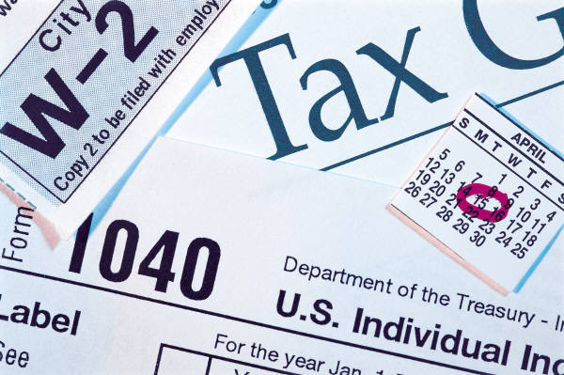
9-Way or No Way?
Research shows only 9% of Americans have an income of $100,000 or more per year.

Slide 20
9-NO WAY
Research shows 18% percentage of Americans make over 100k a year; and that 35% of Households make that much
“Whoever said that money can’t buy happiness simply didn’t know where to go shopping.”
— Bo Derek

Slide 21
10-Way or No Way?
In 2022, the share of people in the U.S. middle class varied from 46% to 55% across all racial and ethnic groups.

Slide 22
10-WAY
While the income range is quite broad for households considered “middle class,” middle class households have seen both their numbers, and their cut of the pie shrink.

Slide 23
11-Way or No Way?
Men with bachelor's degrees earn approximately $600,000 more in median lifetime earnings than high school graduates. Women with bachelor's degrees earn $430,000 more.

Slide 24
11-NO WAY
Men with bachelor's degrees earn approximately $900,000 more in median lifetime earnings than high school graduates. Women with bachelor's degrees earn $630,000 more.
Men with graduate degrees earn $1.5 million more in median lifetime earnings, while women earn $1.1 million.

Slide 25
12-Way or No Way?
The median household income in the United States in 2023 was $80,610.
-US Census

Slide 26
12-WAY
The median income is the center, one-half of the households earn less than $80,610, and the other half earn more.
— U.S. Census
Notes:
The median income in Mississippi is less than $42,000 and over $65,000 for New Jersey.

Slide 27
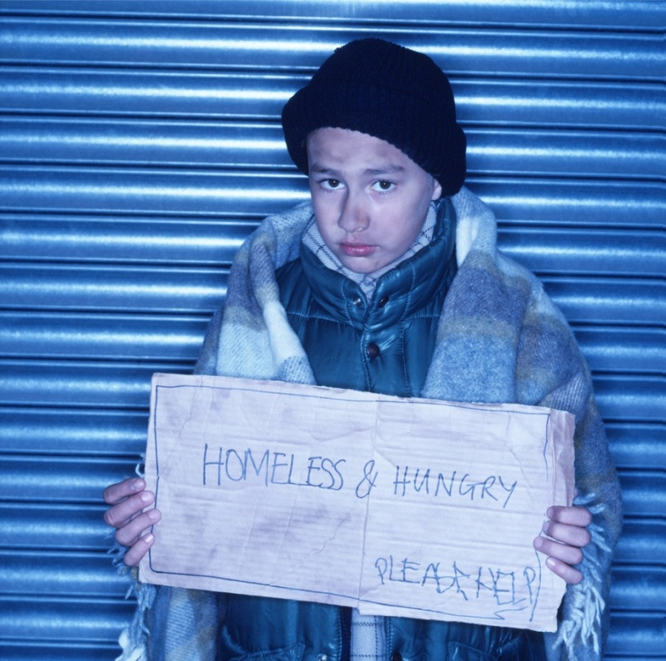
13-Way or No Way?
In 2023 the official poverty rate in the US was 11.1 percent.

Slide 28
13-WAY
The poverty rate fell to 11.1% in 2023 from 11.4%; 43 million Americans or 13% are currently living in poverty.
- U.S. Census & Peter G. Peterson Foundantion

Slide 29
14-Way or No Way?
More than half (55%) of Americans spend equal to or more than their total income; including 57% of millennials, 58% of Gen Xers, and 49% of baby boomers.
“Never spend money before you have it.”
— Thomas Jefferson

Slide 30
14-WAY
In a survey, 58% of respondents stated that the COVID-19 pandemic changed their approach to savings.
28% of people with a household income less than $35,000 were able to grow their savings during the pandemic.
But as of March 2024, estimates show that overall excess savings in the U.S. economy have been fully depleted.

Slide 31
15-Way or No Way?
61% of students who completed a Bachelor’s degree have received student loans.

Slide 32
15-WAY
The average 4-year Bachelor’s degree debt from a public college is $31,960.

Slide 33
16-Way or No Way?
A survey found 37% of Americans have been charged a late fee on their bills over the past 12 months.

Slide 34
16-NO WAY
Over 50% of Americans do not pay their credit card bills in full each month. The average U.S. household with credit card debt has a balance of around $6,065. And overall Americans owe $1.1 Trillion in credit card debt.
- U.S. Federal Reserve & LendingTree

Slide 35
17-Way or No Way?
According to a study from the research firm Teenage Research Unlimited, more students drop out of college because of debt than for academic reasons.

Slide 36
17-WAY
About half of students at risk of dropping out said it is difficult for them to meet the cost of tuition as well as other related expenses, such as textbooks, housing and food, according to report from CNBC.

Slide 37
18-Way or No Way?
When making the minimum payment it takes 11 years to pay off a $2,000 debt on a credit card with an 18.5% interest rate.

Slide 38
18-WAY
When you make the minimum payment, it takes 11 years to pay off a $2,000 balance and the interest charges will be almost $1,900. Paying only the minimum payment almost doubles the cost.

Slide 39
19-Way or No Way?
According to student loan provider Sallie Mae, about 57% of students have a credit card.

Slide 40
19-WAY
Most teenagers access credit cards with help from their parents and often use them for school expenses or online purchases.

Slide 41
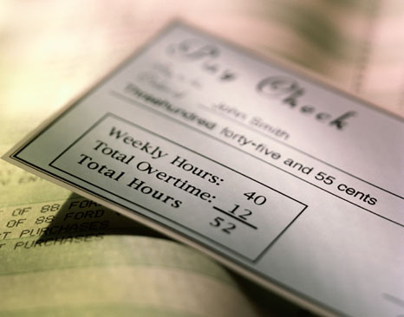
20-Way or No Way?
22% of Americans occasionally live paycheck to paycheck.

Slide 42
20-NO WAY
Not only do 78% of Americans occasionally live paycheck to paycheck, but many have no money left after paying basic monthly expenses.
- Forbes
Notes:
40% live paycheck to paycheck every month, while an additional 37% report living that way some months during the year

Slide 43
21-Way or No Way?
There are more payday lending stores in the United States than McDonald’s and Starbucks stores combined.

Slide 44
21-WAY
The number of payday lenders in the U.S. is about 23,000 — twice that of McDonald's and Starbucks.
As many as 12 million Americans used payday loans in 2022.
- DebtHammer.org

Slide 45
22-Way or No Way?
A typical two-week payday loan, with a $15 per $100 fee, equates to an annual percentage rate (APR) of almost 400 percent.
Notes:
Cash Advance

Slide 46
22-NO WAY
Though the interest rates commonly are disguised as fees, they effectively range from 390%-780% annual percentage rate (APR).
- Maine Center for Economic Policy
This is sometimes termed “predatory” lending.

Slide 47
23-Way or No Way?
The US Department of Agriculture estimates that feeding a family of four at home for one month, using what they term the “low-cost” plan, would cost $984.60

Slide 48
23-NO WAY
The low-cost food plan is used by bankruptcy courts as a guide for how much to allow for food expenses. But the actual range is $748-822 for a family of four per month.
— USDA Food Plans

Slide 49
24-Way or No Way?
Many experts agree that you should not worry about saving until you have financial security and want to buy your first home.

Slide 50
24-NO WAY
From your first paycheck you should PYF (pay yourself first) and begin to save for short- and long-terms goals.
Experts recommend that you save between 10% and 20% of your income each month.
— choosetosave.org

Slide 51
25-Way or No Way?
The average worker works 109 days each year to pay federal, state, and local taxes and fees.

Slide 52
25-WAY
That means Americans will work nearly four months of the year, from January 1 through mid- April, before they have earned enough money to pay their yearly tax obligations at the federal, state and local levels.
Tax Freedom Day is the day that American taxpayers have finished paying their tax burden for the year.
— Tax Foundation.org
Notes:
What benefits do teenagers receive from taxpayers being willing to “shoulder the this tax burden?”

Slide 53
26-Way or No Way?​
Once you are on your own, you need about two months of income put away for emergencies or to pay living expenses should you lose your job or become ill.​

Slide 54
26-NO WAY
You need to have at least 3-6 months of living expenses in an emergency savings account which you do not spend unless unexpected circumstances demand it. Repay the account as soon as possible.

Slide 55
LifeSmarts is:
An educational program teaching teens and tweens important real-life knowledge
A competition – students compete online and in-person
A teaching toolbox – check out our resources
An opportunity for students to gain leadership skills, and fulfill community service requirements
A chance to develop strong partnerships with national groups such as 4H, FBLA, FCCLA, SkillsUSA, and BPA
Visit LifeSmarts at lifesmarts.org

