Slide 1
WEARABLE
TECHNOLOGY
COLUMBIA COUNTY, GA
Ash “Sara” Sonnier
Austin Marruffo
Hope Burcaw
Daniel McQuillan

Slide 2
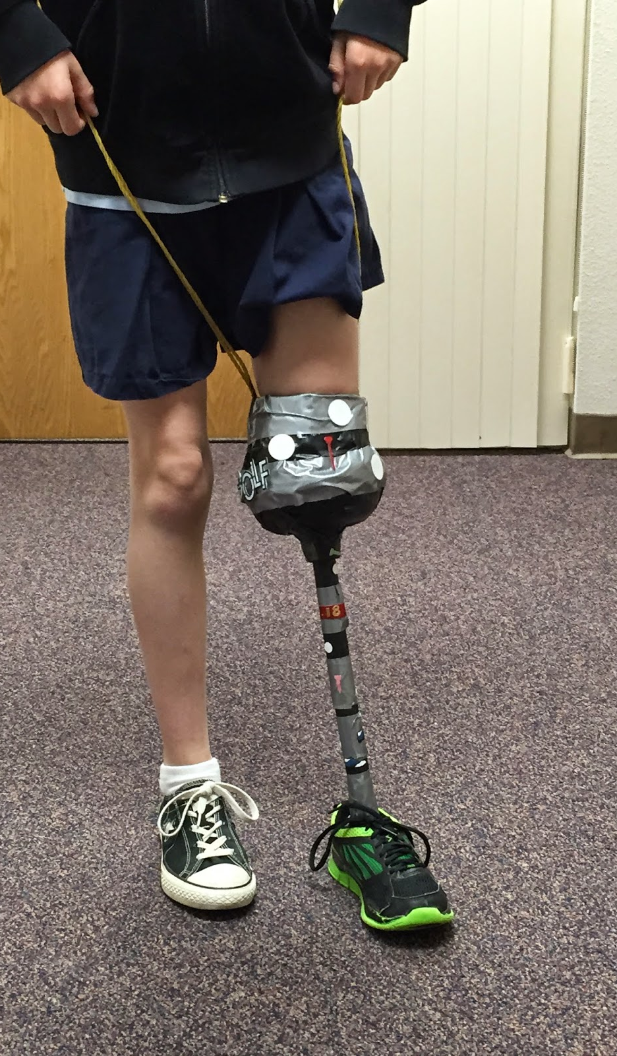
What Is Wearable Technology?
Wearable technology is any kind of electronic device designed to be worn on the user's body. Wearable technology in healthcare refers to devices that patients attach to their bodies to collect health and fitness data, which they may provide to doctors, health providers, insurers and other relevant parties.

Slide 3
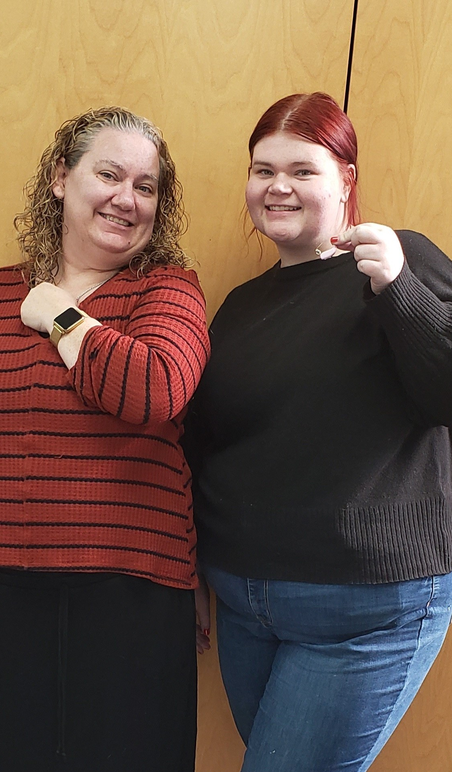
Effects / Audience
With wearable technology in healthcare, the effects spread further than most people think. Wearable technology is used by everyone who has any sort of disability, from hearing impaired individuals that use hearing aids, to people with heart problems and their pacemakers. Wearable technology is the most widespread form of healthcare within the technological industry. We even have members of our own team and faculty staff that rely on wearable technology in their daily lives.

Slide 4
The Problem
Wearable health technology, while widely available, remains inaccessible for many who need it most. Most devices are not covered by insurance and can cost between $700 to $5,500. With over 61 million disabled adults in the US, more than half lack access to essential wearable technology due to financial barriers.

Slide 5
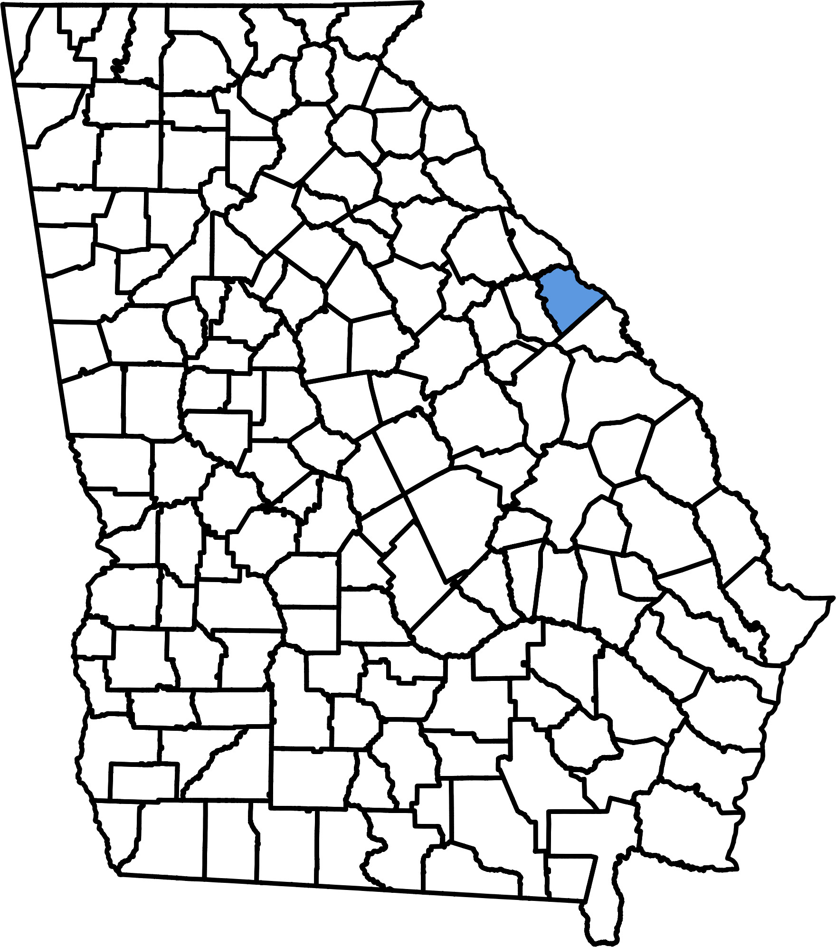
In our community
In columbia county, 25% of the overall population is disabled, including our very own members on the lifesmarts team, and 6,900 of those people don't have access to the wearable technology they require. Most of the accessibility to wearable technology is centered in Atlanta, so most people not living in the area don't have access to the technology they can help them to thrive.

Slide 6
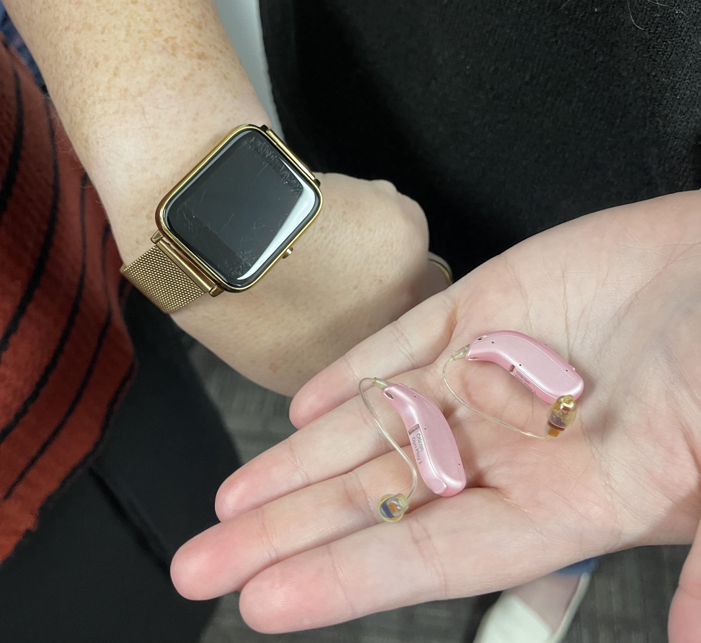
Health System
Within the healthcare system and especially in the prosthetics division, most wearable technology is not included in insurance policies this leads individuals to have to pay out of pocket for any technology and prosthetics they need. Furthermore, members have to pay for both the treatment and testing of such technologies, which leads individuals to pay hundreds of thousands of dollars in order to get the treatment they need in their lifetime. This leaves people with 2 options: go broke or suffer without proper help.

Slide 7
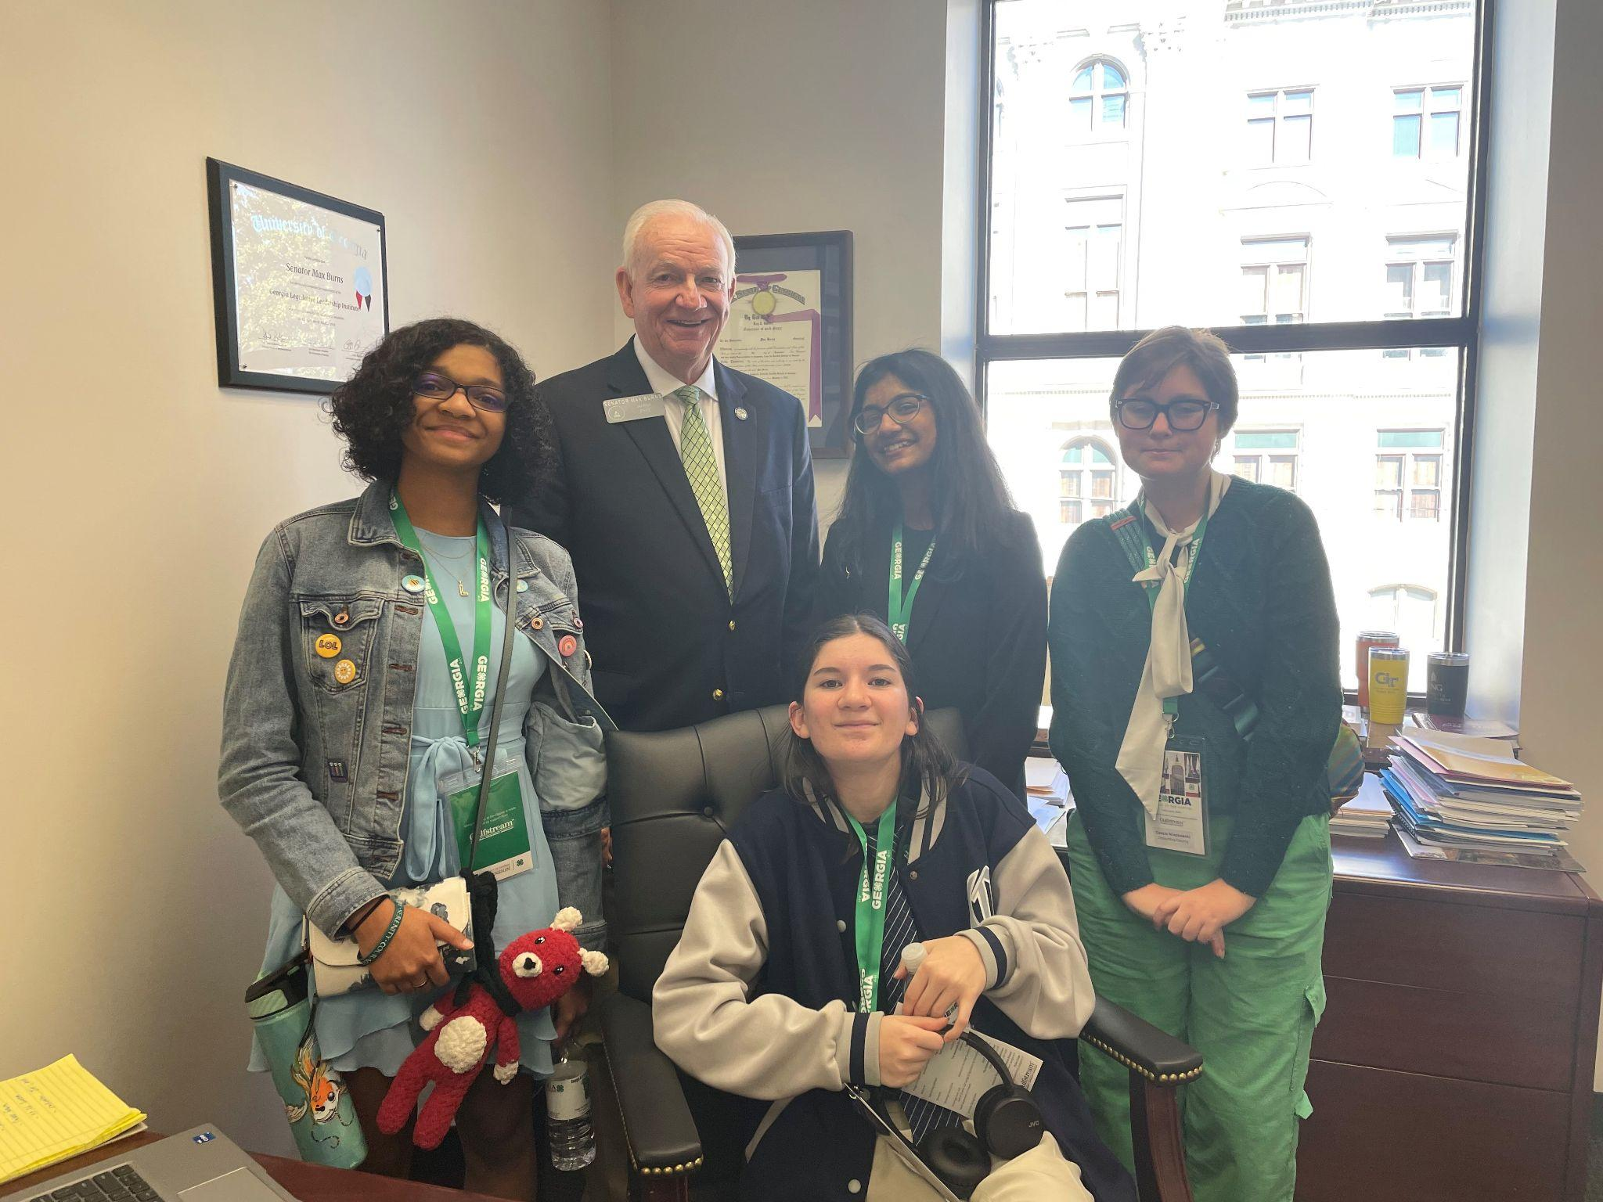
Call to action
As some of our lifesmarts members are members of the disabled community, we find the issue of access to wearable technologies to be of crucial importance. No individual should be denied access to something that can help them thrive, and even save their life. This issue is not just about the economic cost, it’s about saving lives overall in America and for the betterment of society.
CALL TO ACTION
Our district representative

Slide 8
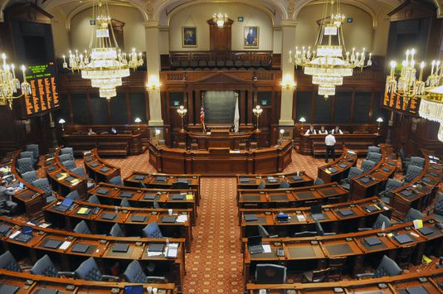
What can we do?
To address the issue effectively, we must first acknowledge its existence. Next, we need to raise awareness among locals and local governments, leveraging our democratic power to enact change. Finally, holding healthcare systems accountable through various means such as boycotts, critical content, or local protests, is crucial. This is a collective problem requiring collective action - each of us can play a part in making a difference.

Slide 9
Cite page
“National Center on Disability and Access to Education.” Ncdae.org, ncdae.org/.
“Prosthetic Liners.” Amputee Store, amputeestore.com
Rudnicki, Tara. “ATIA.” Assistive Technology Industry Association, 24 Aug. 2014, www.atia.org/.
Schroer, Alyssa. “Care Worn: 11 Companies Using Wearable Technology in Healthcare.” Built In, 2019, builtin.com/healthcare-technology/wearable-technology-in-healthcare.
US Census Bureau. “American Community Survey (ACS).” Census.gov, 13 Mar. 2019, www.census.gov/programs-surveys/acs/.
Yasar, Kinza. “What Is Wearable Technology? - Definition from WhatIs.com.” SearchMobileComputing, May 2022, www.techtarget.com/searchmobilecomputing/definition/wearable-technology.

