Slide 1
Food Waste
What is it, Why it matters, and How to prevent it

Slide 2
Why Food Waste Matters:
30-40% of the food supply is wasted
Benefits of Less Food Waste include:
This food could be used to feed the nearly 13% of Americans who struggle with Food insecurity (USDA)
Reducing food waste by just 15% could feed an additional 25 million Americans
Labor cost savings through more efficient handling practices
Lower cost when purchasing food
Reduced methane emissions
Better energy and resource management
Prevents further pollution from food production
Community benefits through donating food that would instead be wasted
95% of food waste ends up in landfills
Decomposes and produces Methane which contributes to global warming

Slide 3
What is Food Waste and why does it occur?
Types of Food Waste:
Reasons for Waste:
Food “loss” occurs before the food reaches the consumer
Food “waste” refers to food that is fit for consumption but is discarded at the consumer level
Spoilage
Improper drying, milling, or transportation
Exposed to insects, rodents, etc
Retail over-ording or culling of blemished produce
Consumers buying and cooking more than they need–throwing out the rest

Slide 4
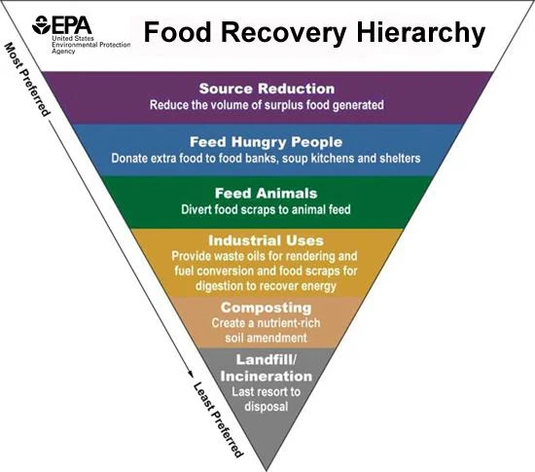
Ways to Reduce Food Waste (EPA)
The Food Recovery Hierarchy Pyramid, outlined by the EPA, details the prioritized actions to reduce food waste:
Source reduction: Earliest prevention by reducing the overall volume of food produced
Feed hungry people: Donating excess food to community sites
Feed animals: Donating food scraps and waste to local farmers who can use them for animal feed
Industrial uses: Donating used fats, oils, and grease to make biodiesel fuel
Composting: Food waste that is composted to produce organic matter that is used to fertilize soil
Landfill/Incineration: A last resort for unused food

Slide 5
Prevention Planning in Government and Business
State and Local Governments
Businesses (Restaurants and Farms)
Can enact food waste and prevention campaigns
Implement composting programs
And provide tax credits to farmers who donate excess produce
Sell damaged or expired produce at discounts
Restaurants should offer small portions and donate excess ingredients
School should give children the choice to create meals and prevent discarded food
Farms should evaluate food losses during processing, distribution, and storage and adopt practices. Sell ugly produce to food banks at a reduced rate

Slide 6
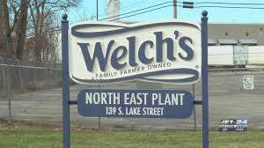
Case Example:
North East PA’s Welch’s plant
Here in North East PA is the largest manufacturing plant of Welch’s grape products
Thousands of tons of grapes are processed for juice and sugar every year
Grape Pulp from the production of grape juice is used as fertilizer for local farmers
Thus, grape pulp that would otherwise be wasted is diverted and used to grow more crops
Mazza Vineyard
Erie Times News

Slide 7
Prevention Planning at Home
Ways to Prevent Food Waste at home
Storage Tips & Maximizing Freshness
Plan your meals for the week before you go shopping
Keep running a list of meals, ingredients with quantities
Look in the refrigerator, freezer, and pantry to avoid overbuying food
Only buy in large quantities if you will eat them before they spoil
Buy from bulk bins and purchase imperfect produce or upcycled products
Keep veggies prone to wilting in the High Humidity Drawer
Store items that tend to rot in the Low Humidity Drawer
Keep ethylene-producing fruits (bananas) away from other produce
Wait to wash fruits until ready to eat.
Store produce in cool, dark, well-ventilated places.
Maintain 40°F or below in the fridge.
Use airtight containers for grain; label with contents and dates.
Freeze excess food; label with contents and dates.

Slide 8
Prevention Planning at Home (Continued)
Cooking, Preparation, and Serving
Difference between “Sell-by,” “Use-by,” Best-by,” and “Freeze-by”
Produce past its prime may be fine for cooking or can be repurposed
Freeze, pickle, dehydrate, can, or make jam/jelly with surplus fruits and veggies
Don’t leave perishable food at room temp. For more than two hours
Refrigerate or freeze any leftovers in clear, labeled containers
“Best if Used By/Before" date signifies optimal flavor or quality; not a safety date.
“Sell-By" date guides store display for inventory; not a safety date.
"Use-By" date recommends the last date for peak quality; generally not a safety date except for infant formula.
“Freeze-By" date indicates when a product should be frozen for maintaining peak quality; not a safety or purchase date.
If you Can’t Reduce Wasted Food
Donate untouched food to food banks
Compost food scraps rather than throwing them away

Slide 9
Thank You for Listening!
Works Cited:
“Food Product Dating.” Food Safety and Inspection Service, U.S. Department of Agriculture, www.fsis.usda.gov/food-safety/safe-food-handling-and-preparation/food-safety-basics/food-product-dating. Accessed 27 Feb. 2024.
“Food Waste Faqs.” USDA, U.S. Department of Agriculture, www.usda.gov/foodwaste/faqs. Accessed 27 Feb. 2024.
“Food Waste.” The Nutrition Source, Harvard School of Public Health, 30 Nov. 2022, www.hsph.harvard.edu/nutritionsource/sustainability/food-waste/.
Lai, Olivia. “Explainer: What Is Food Waste?” Earth.Org, Earth.Org, 26 Sept. 2023, earth.org/what-is-food-waste/.
“Preventing Wasted Food At Home.” EPA, Environmental Protection Agency, www.epa.gov/recycle/preventing-wasted-food-home. Accessed 27 Feb. 2024.
“Wasted Food Scale.” EPA, Environmental Protection Agency, www.epa.gov/sustainable-management-food/wasted-food-scale. Accessed 27 Feb. 2024.
“Where You’ll Work.” Welch’s, www.welchs.com/careers/where-we-work/. Accessed 2 Mar. 2024.
This presentation template was created by Slidesgo, and includes icons by Flaticon and infographics & images by Freepik

