Slide 1
Preparing For and Financing College
By Cumberland Valley

Slide 2
Why This Topic?
With 4 seniors on our team, we felt that the research done here could be directly applied to our lives.
Properly financing college is the first step toward initiating one’s future success in all financial areas.
With the cost of college becoming an increasing financial burden to families, people of all income brackets must anticipate the associated risks, benefits, and impacts.
With four seniors and two juniors on our team, we all must understand the multifaceted challenges of applying to college. This affects millions of students every year, so we decided to learn a bit more about the current academic climate of our country.

Slide 3
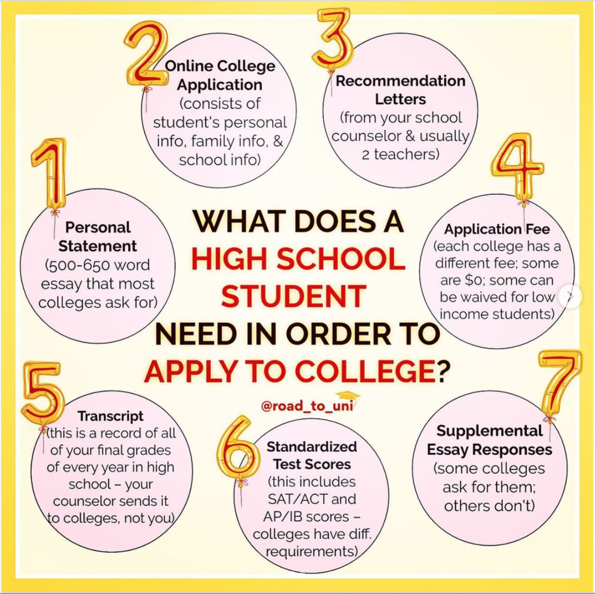
Steps For Preparation: Sophomores and Juniors
IV. Check to see if your colleges of interest require the submission of any test scores (SATs, ACTs, or other standardized tests). Either way, test score submission is strongly encouraged as an application booster.
I. Post-secondary starts with secondary!
Take core classes that reflect your interests and plans. If you’re undecided, branch out! Most college admissions offices employ a holistic lens when looking at applications, so success in multiple disciplines is key regardless of your intended pathway.
Implement and keep records of participation in extracurriculars.
II. Build relationships with counselors, mentors, coaches, teachers, and advisors.
Not only are these people great for recommendation letters, they are also resources for guidance moving forward.
III. Begin visiting campuses and get an idea of what you like (location, size, distance, etc).

Slide 4
Steps For Preparation: Seniors
III. Start ahead of time. Most applications open over the summer between Junior and Senior year, so it can be beneficial to start filling out applications right away (the same principle applies to documents like the FAFSA).
Many colleges use rolling admissions; the earlier you apply, the more likely you are to get in!
Consider applying to service academies, especially for STEM, communications, leadership, or aerospace careers. They offer a high-quality education, and some are free or even pay you to attend. The catch is that you need to serve in the military for a few years after graduation and be in shape.
IV. Be cautious of the “college bandwagon.”
Reputable schools can be very expensive. Be sure to select a school that is right for you, not one that is carried by its reputation alone. Do your own research.
V. Be sure to consider the tuition cost in combination with other costs such as room and board, dining expenses, travel, etc.
I. RECORD EVERYTHING.
There are so many dates that come with college readiness. Keep track of when Common App opens, application deadlines, transcript deadlines, scholarship deadlines, FAFSA availability, and, eventually, commitment deadlines.
Knowing what to do when is the key to staying organized.
II. Always be looking for financial aid options. Usually, schools will offer their own opportunities, but applying for the FAFSA regardless of income is a great way to secure financial aid.
Find extracurricular scholarships through sources like FastWeb, College Board, Naviance, and Scholarship Owl.

Slide 5
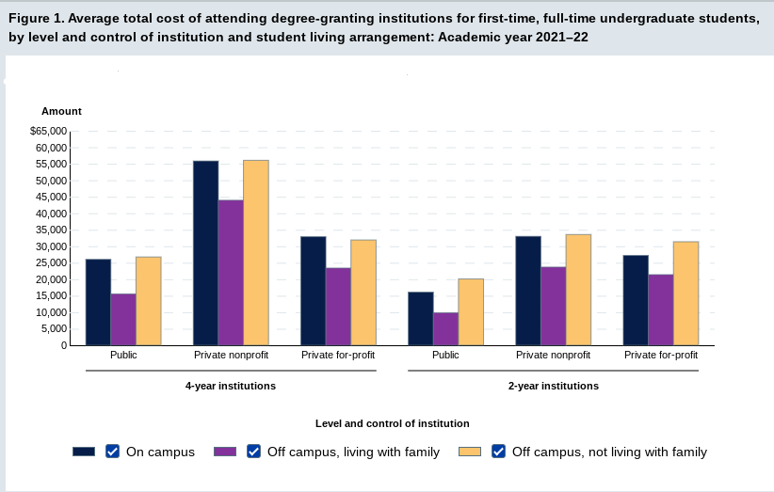
How To Pay For College: Student Loans
Direct Subsidized Loans - No interest
Unsubsidized Loan - Interest accumulates
Direct PLUS Loan - Loan paid off by both parent and student. Interest accrues.
Direct Consolidation Loan - All loans combined with a fixed interest rate. Eligible for forgiveness programs.
The average public university student borrows $32,637 to attain a bachelor’s degree.
The federal share of the total student loan debt balance increased 3.11% from 2017 Q2 to 2022 Q2
55% of Americans support cancellation of up to $10,000 per borrower in federal student loans; 47% support cancellation of up to $50,000 per borrower.
20% of U.S. adults report having paid off student loan debt.
The 5-year annual average student loan debt growth rate is 15%.
2 Scenarios for paying off Student Debt:
High income means easier to pay debt.
Pay for it biweekly or monthly.
Interest is dangerous, so pay loans sooner.
Low income means harder to pay off debt.
Regardless, the loan you pay is important.

Slide 6
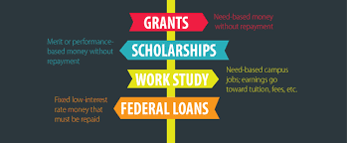
How To Pay For College:
Other Types of Financial Aid
How Do I Begin The Scholarship Search?
Sign up for a Scholarship matching service like Scholarships.com.
Look into your desired university’s financial aid website for potential merit and need based scholarships
Many organizations (like LifeSmarts) have scholarships available to student competitors. Look into what’s available for your activities!
There are two other primary types of aid:
Need-Based
Awarded based on a student’s financial situation
Either awarded by the University or the Government (state or federal)
Merit-Based
Usually called scholarships
Awarded based on a student’s accomplishments (academic, athletic, service)
How Do I Know if I Qualify for Aid?
Start by filling out the FAFSA (check out slides 7&8 for more info)
Search for grants based on your income, major, or university
Most Ivy league schools have programs to help out with tuition
Look into Federal work-study programs
These are special programs where you can work within your field during college and earn money to pay for college.

Slide 7
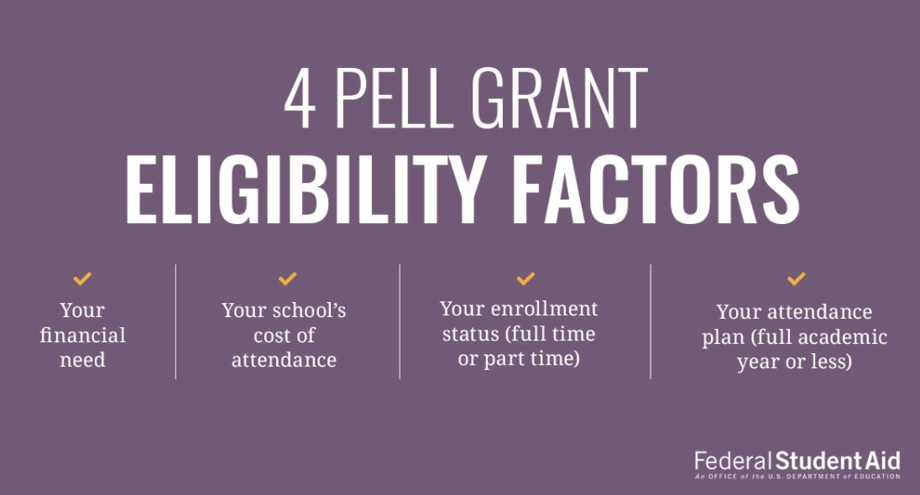
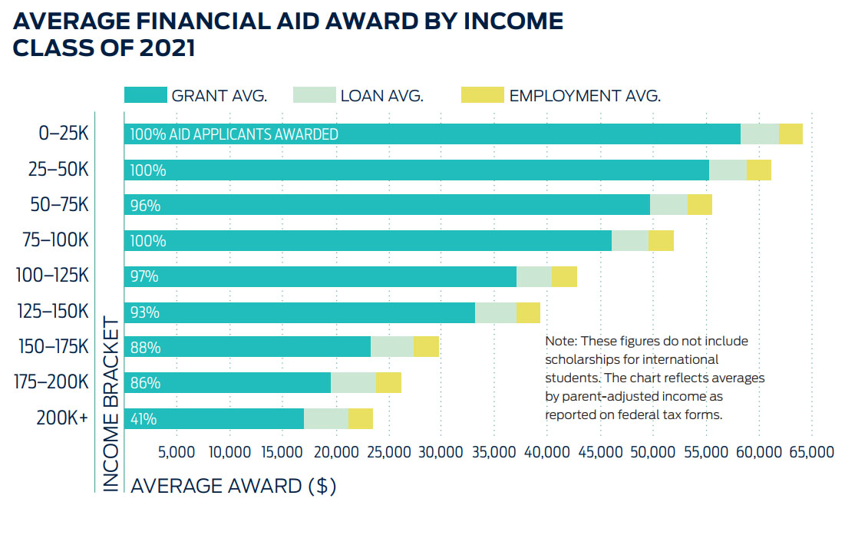
Governmental Assistance
The government provides many ways to help students pay for college, such as the FAFSA, Pell Grants and TEACH Grants, and the Public Service Loan Forgiveness (PSLF) Help Tool.
Students can receive up to $7,395 per year with Pell Grants. For some schools, that covers nearly half of tuition costs.
The PSLF allows public servants to have their student loans forgiven after ten years of employment. This includes health care workers, first responders, educators, and military personnel.

Slide 8
Free Application for Federal Student Aid
What is it?
How do I complete it?
FAFSA Simplification Act
Types of Aid
The FAFSA is how students apply for federal aid to help them pay for college or career school. It is completely free to apply, and in order to receive consistent aid, you must reapply every year. Filling out the FAFSA is strongly encouraged regardless of a student’s financial situation, as millions to billions of dollars are left unclaimed every year by students who did not file a FAFSA.
You’ll answer a series of questions that should take less than an hour. There are two ways to complete the FAFSA: online or on paper. Online is strongly recommended, as this option (available at https://studentaid.gov/) allows users to get help where needed with built-in tips for success. It is also easier to keep track of online forms. You will need to reference your family’s income information, such as tax returns, throughout the application process.
This act streamlined the FAFSA form and expanded access to Federal Pell Grants. This was intended to make it easier for families to understand the FAFSA, thus maximizing aid. For example, the changes made include the implementation of the Student Aid Index, fewer questions on the form, the removal of the sibling discount, and availability in the 11 most-spoken languages in the United States.
Filling out the FAFSA can help you receive grants, scholarships, work-study funds, and student loans. Each year, $120 billion in grants, work-study, and low-interest loans is offered by the U.S. Department of Education. Some merit-based scholarships from colleges require the FAFSA to determine the awarded amount.

Slide 9
Bibliography
https://www.up.edu/ready-for-college/how-to-prepare-for-college.html
https://www.inspiruseducation.com/what-changed-in-sat-exam-digital-sat-2023/
https://studentaid.gov/help/fafsa
https://studentaid.gov/help-center/answers/article/fafsa-simplification-act
https://studentaid.gov/teach-grant-program
https://studentaid.gov/pslf/
https://www.investopedia.com/terms/1/529plan.asp
https://nces.ed.gov/fastfacts/display.asp?id=900
https://educationdata.org/student-loan-debt-statistics
https://www.mefa.org/blog/what-you-need-to-know-about-merit-based-financial-aid
https://www.usnews.com/education/best-colleges/paying-for-college/slideshows/things-to-know-about-merit-aid-scholarships
https://www.nerdwallet.com/article/loans/student-loans/fafsa-simplification-8-changes-to-expect
https://blog.collegeboard.org/what-is-the-fafsa

