Slide 1
Retirement basics
By: cobb county 4-h lifesmarts team

Slide 2
What is retirement?
Retirement is all about planning ahead.
Retirement refers to the point in which an individual chooses to leave the workforce for good to collect their social security benefits.
Around 10-15% of your income per year should go into retirement.
The average age range people retire is 61-67 years old.

Slide 3
Why retirement?
Important to start now. Opportunity to build up savings.
As working teenagers, we have been exposed to stock investments, creating a savings account, Pay Yourself First, compound interest, etc. to build up money over a longer period of time.
With Social Security decreasing each year and the age of retirement increasing, there are less benefits for us to look forward to as a senior citizen. Important to "begin with the end in mind" especially as we advance to post-secondary education.
Researching this information allows us to get a better idea on how to work on retirement planning.
Essential for our future financial outlook.

Slide 4
Other Key Terms
Pay Yourself First: This is the idea that before using money towards other things, you should put money into your savings account first. Making this a habit can make saving money feel a lot easier.
Emergency Fund: This is money that is put away in case of unexpected events. Emergency funds should cover at least three to sixth months.
Delayed Gratification: This refers to the economic decision to postpone purchasing a reward to save money and avoid unnecessary purchases.
Savings Account: Interest-bearing deposit account held at a financial institution; saves money and builds more money.

Slide 5
Why start Planning now?
Thinking about retirement now allows for adequate time to plan and make decisions on the type of lifestyle you plan to have in retirement.
Saving even just a small amount per month can quickly add up overtime.
When first entering the workforce, it is important to be aware of the employer-sponsored savings accounts towards retirement.

Slide 6
Choosing the right retirement plan
The right retirement is all about what you want/need and what works best for you.
A few programs include:
Payroll Deductions: Employees contribute to an IRA through payroll deductions.
Salary Reduction Simplified Employee Pension: Employers make contributions to their own IRA and the IRAs of their employees.
401(k) Plan: Employees defer some of their salary.
Profit-Sharing Plan: Gives employees a share in the company's profits based on earnings.
Money Purchase Plan: Retirement plan that requires companies to contribute a specific percentage.
Defined Benefit Plan: Provides a fixed, pre-established benefit for retiring employees.

Slide 7
Investing vs Saving Which is best for you?
Saving means that you are setting funds aside for future use. With a savings account you can also gain interest, increasing the money in the account. Simple interest accumulates on the principal amount that is invested, whereas compound interest accumulates on the principal and the interest of other previous periods.
Investing involves putting funds in an asset with the expectation of that asset appreciating but the risk of it not.

Slide 8
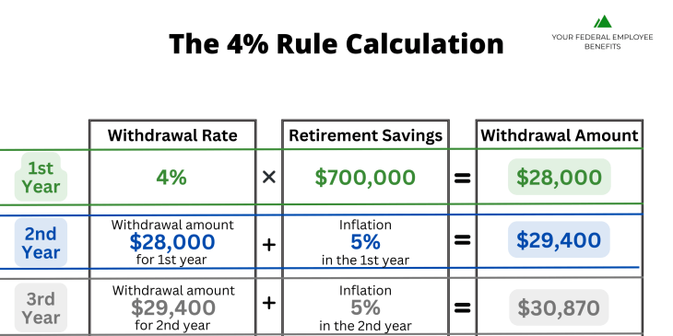
The 4% rule of retirement
Safely withdraw the amount equal to 4% of savings during the year they retire.
Adjust for inflation each subsequent year for 30 years.
High probability of not outliving your money during a 30-year retirement.
Consider: How long you expect to live in retirement, how much you will need to live comfortably, lifestyle, and goals.

Slide 9
sources
Ready to secure your future?
Get started now with
just one click!
https://www.forbes.com/advisor/retirement/retirement-planning-checklist/
https://www.investopedia.com/terms/r/retirement.asp
https://www.aarp.org/retirement/planning-for-retirement/info-2023/never-too-late-to-start-saving.html
https://www.ssa.gov/pubs/EN-05-10377.pdf
https://money.usnews.com/money/retirement/aging/articles/common-retirement-goals
https://myucretirement.com/Resource/222
https://lifesmarts.org/resources/content-vocabulary-of-the-week/
https://www.aarp.org/retirement/retirement-calculator/

