Slide 1
Why is it important to learn about credit scores?
Credit scores help lenders decide whether you get a mortgage, a credit card, or some other line of credit.
Credit scores determine the interest rate you are charged for any line of credit.
Insurers use credit scores to set premiums for auto and homeowners coverage.
The length of time you have credit matters, start early.
It takes time to build a good credit score, it’s better to maintain a good score than to try to fix a bad score.

Slide 2
What Are the Differences Between a Credit Score and a Credit Report?
Credit Reports
Credit Score
Offers potential lenders and creditors a summary of your credit history.
Lists information used to calculate your credit score.
Assembled into four categories:identifying information, credit accounts, credit inquiries, and public records.
Free once a year from each bureau.
Calculated based on the information in your credit report.
Single numerical grade of creditworthiness that may not give an accurate full picture of your history.
Calculated using five weighted categories.
Can cost money to receive unless provided by your creditors.

Slide 3

What Factors Make Up Your Credit Score?
35% Payment History
30% Amount Owed/Credit Utilization
15% Age of Credit
10% Credit Mix
10% New Credit

Slide 4
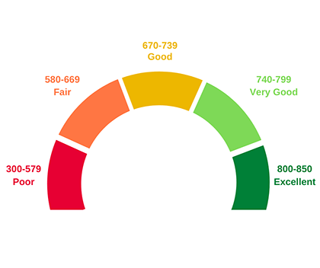
What Are the Possible Credit Score Ranges?
300-579: Poor.
580-669: Fair.
670-739: Good.
740-799: Very good.
800-850: Excellent.

Slide 5
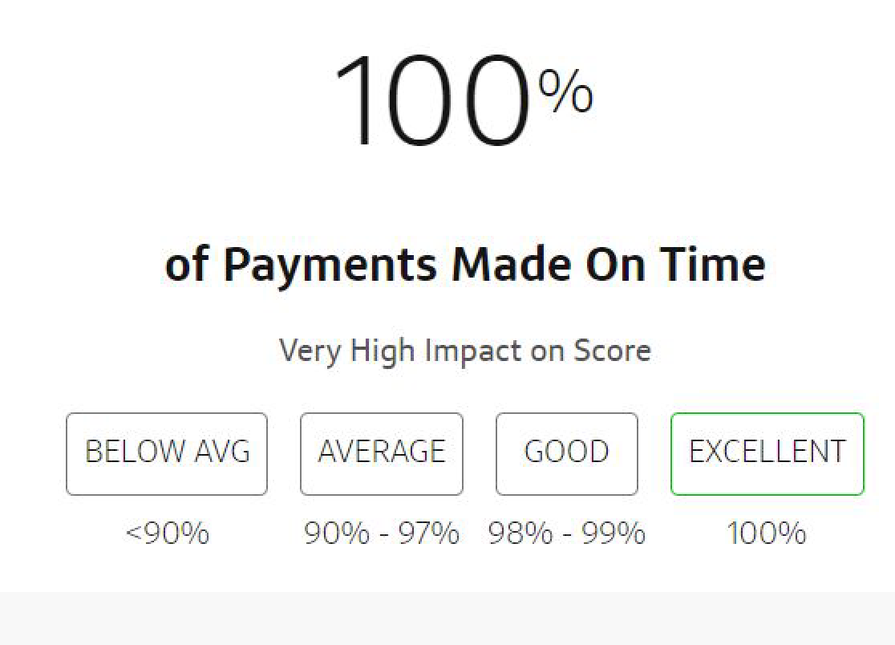
How to achieve a good payment history?
Always pay your bills on time. Late or missed payments can affect your credit score for 7 years.
Get and stay current on any missed payments.
Follow a debt management plan.
Communicate with your creditors.
Consider a debt consolidation loan.
Always pay at least the minimum amount due.

Slide 6
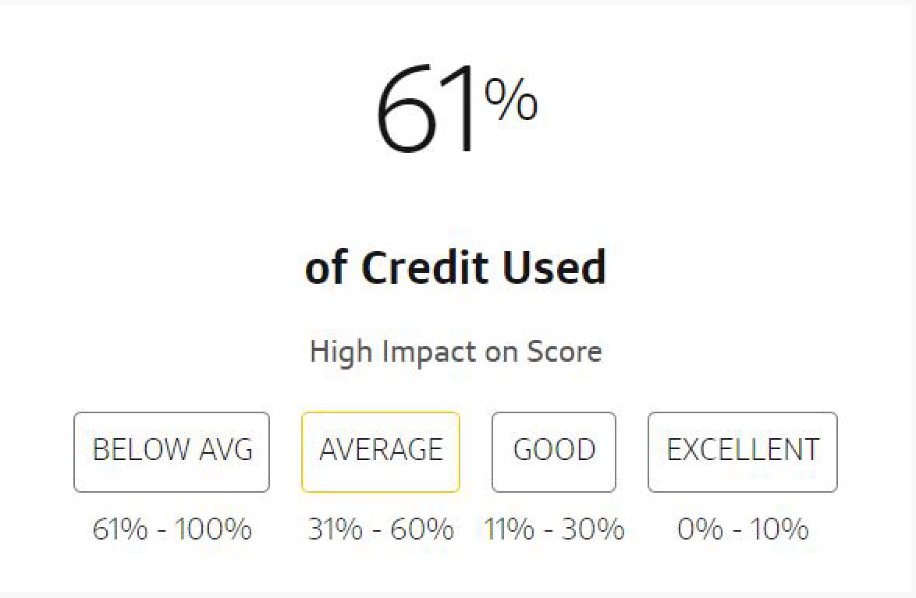
What is Good Credit Usage?
Creditors look at the amount of your available credit you use.
This is expressed in the form of a percentage.
  Amount you owe/amount you can borrow in total
This can also include the amount of possible credit you still have available to borrow.
For a good ratio, try to keep your utilization below 30%

Slide 7
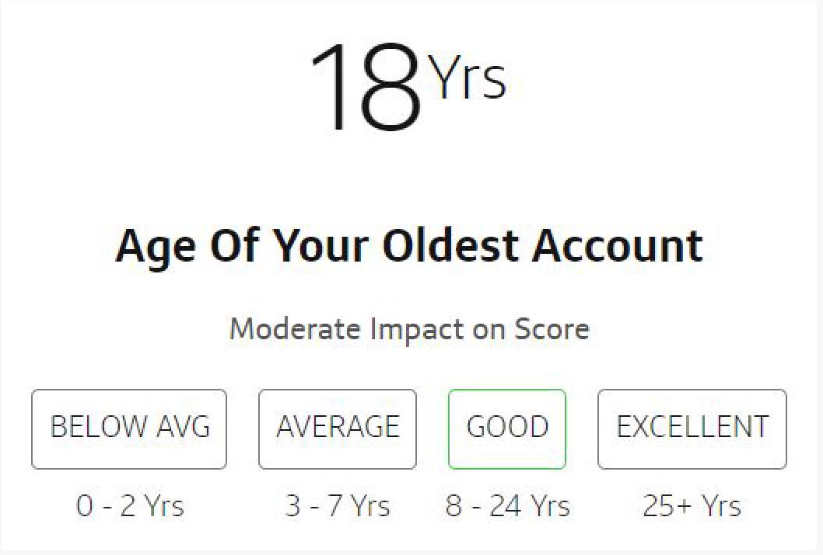
Wait, How Can I Improve My Credit Age?
EXACTLY!
The only way to improve your credit age is to wait.
You can help by getting a credit card as soon as you are eligible and keeping that same card open forever.
  If you close that card, your credit age will go down.
Don’t rely on installment credit as they will eventually go away and lower your age as well.

Slide 8
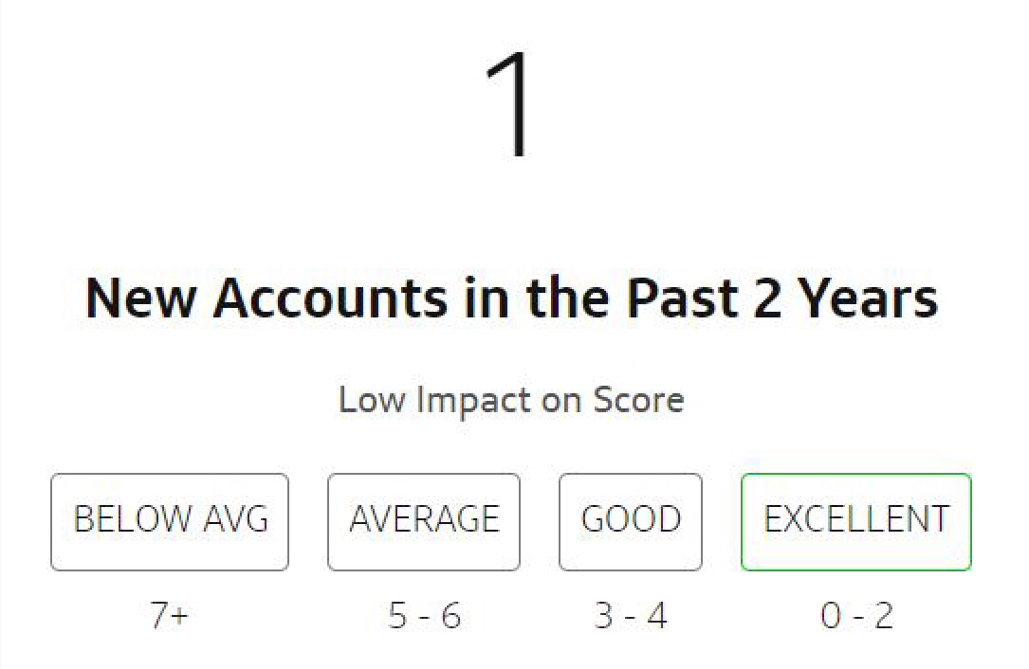
What Type of Debt is Best for My Credit Score?
It is best to use a variety of types of credit.
For a balanced credit score, you want both revolving and installment credit.
If you need to add new credit to get a good mix, try to keep your new credit below 2 new accounts over two years.

Slide 9

Bibliography
For a fun, educational video about credit scores, click the link below!
https://www.finra.org/investors/personal-finance/how-your-credit-score-impacts-your-financial-future
https://www.consumerfinance.gov/ask-cfpb/what-is-the-difference-between-a-credit-report-and-a-credit-score-en-2069/
https://myhome.freddiemac.com/blog/notable/20210831-factors-credit-score
https://www.equifax.com/personal/education/credit/score/credit-score-ranges/
https://www.wellsfargo.com/financial-education/credit-management/good-credit/
https://www.experian.com/blogs/ask-experian/credit-education/score-basics/credit-utilization-rate/
https://www.chase.com/personal/credit-cards/education/build-credit/how-to-build-credit-at-18
https://thehub.santanderbank.com/7-debt-payoffs-boost-credit-score/
https://www.youtube.com/embed/f2ortkJfTKw

