Slide 1
Recycling
Gordon County 4-H Varsity
Georgia

Slide 2
What is Recycling?
Recycling is the process of collecting and processing materials that would otherwise be thrown away as trash and turning them into new products.
The 3 R’s in Recycling are:
Reduce
Reuse
Recycle

Slide 3
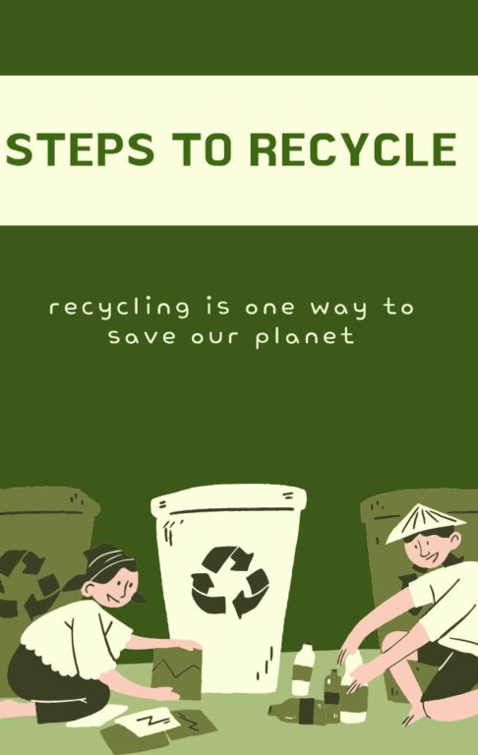
Steps in Recycling
Collection/Processing
Manufacturing
Remanufacturing

Slide 4
How can I Recycle?
Contact your local county or municipality to determine your local recycling options. This will vary according to where you live.
Some places have recycle centers if the locality doesn’t offer pick-up for recycled items.
Our county has a drop off recycle center. (We really need a pickup service. If we had a service provided, more items would be recycled in our community.

Slide 5
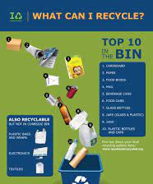
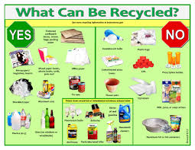
What Objects are Recyclable?
Paper/Cardboard
Plastics
Glass
Aluminum
Batteries
Electronics
Food
Lawn Materials
Used Oil
Household Hazardous Waste
Tires
Metal

Slide 6
Why should I Recycle?
Recycling reduces waste sent to landfills and incinerators.
Recycling prevents pollution.
Recycling conserves natural resources.
Recycling conserves energy.
Recycling creates jobs, producing economic benefits.

Slide 7
Recycling Facts
Recycling one ton of office paper can save the energy equivalent of consuming 322 gallons of gasoline.
Recycling just one ton of aluminum cans conserves more than 152 million Btu, the equivalent of 1,024 gallons of gasoline or 21 barrels of oil consumed.
Plastic bottles are the most recycled plastic product in the United States as of 2018, according to our most recent report. Recycling just 10 plastic bottles saves enough energy to power a laptop for more than 25 hours.

Slide 8
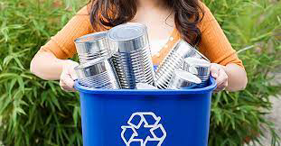
Encourage Recycling in your Community
Use social media and websites to promote recycling and increase participation
Share the importance of recycling with local businesses and residents (acceptable recycling materials and location of recycling facilities)
Create community drop offs and events for recycling
Start in the school: teach children the importance of recycling at a young age

Slide 9
Resources:
https://www.wastedive.com/news/what-does-recycling-actually-mean/551905/#:~:text=“Recycling%20is%20the%20process%20of,your%20community%20and%20the%20environment.”
https://www.epa.gov
https://www.roadrunnerwm.com/blog/50-interesting-recycling-facts
https://www.conserve-energy-future.com/various-recycling-facts.php

