Slide 1
Post-Secondary Education
Oconee County 4-H LifeSmarts Team
State: Georgia

Slide 2
What is Post-Secondary Education?
Post-secondary education, also known as tertiary education, is the education level that follows the successful completion of secondary education, often referred to as high school. Post-secondary education includes universities and colleges, as well as trade and vocational schools.
Unlike primary and secondary school that are mandatory for children under the age of 18, post-secondary education is completely optional.
Did you know: In 2019, high school was the highest level of education completed by 28.1% of the population age 25 and older and 22.5% finished four year of college.

Slide 3
Why Post-Secondary Education?
Post-secondary education serves as a way for students to gain skills, training and knowledge necessary to enter their desired profession.
The median income of someone with a high school diploma is $35,400 compared to $44,800 with a two-year degree, and $56,500 with a four-year degree.
By choosing to pursue higher education you are making yourself a well-rounded individual. Also helping to improve skills like critical thinking, communication (verbal and written), better realization of passions, greater sense of discipline, and lastly it brings a sense of accomplishment when finished.

Slide 4
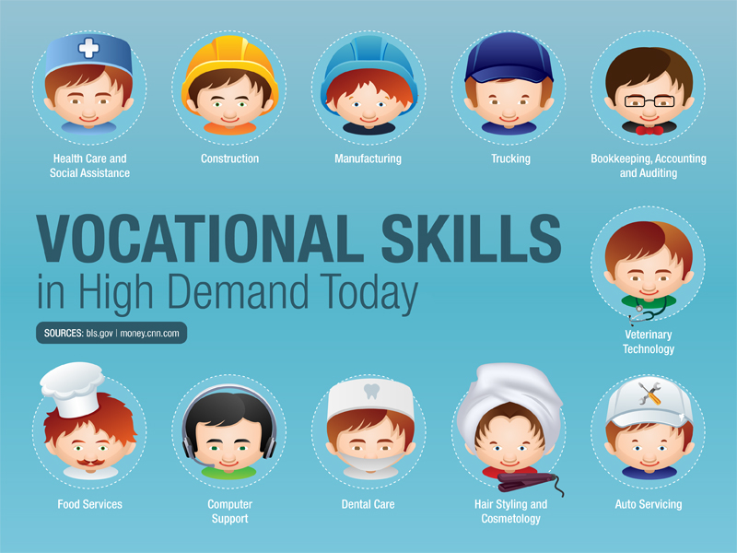
Vocational School
Unlike colleges where students receive academic training for careers in certain professional disciplines, vocational school students do job-specific training where certain physical skills are needed more than academic learning.
Completion of any of these courses provide you with a certificate that shows you have completed and trained for the skill of your choice. This gives you a competitive advantage in the job market compared to other high school graduates who do not have the same training for the skillset you have.
It’s possible to have multiple certificates for different courses if you think this will give you a further advantage, such as being certified as an electrician, plumber, and carpenter if you intend to work in the construction industry.
Example of Vocational Courses:
Health care for nursing
Computer Network Management
Word processing application
Food & beverage management
Fashion designing
Electrician
Plumber
Carpentry
Commercial pilot
Catering and hotel management
Daycare management
Hairstyling and cosmetics
Paralegal studies
Massage therapy
Pharmacy technician
Travel agent
Fun Fact: 57% of all middle school students and 60% of all high school students were enrolled in Georgia Career, Technical and Agricultural Education classes in 2015.

Slide 5
Trade School
Many career paths in Georgia feature a high growth rate, competitive wages, and at least 100 jobs openings per year.
Careers include:
Computer support specialists
Dental hygienists
Web developers
Trade schools focus on career-specific skills and knowledge. Students gain expertise in their field quickly and soon find themselves in the workforce.
Many schools work with regional and industrial partners, tailoring programs to prepare students for local employment.
Did you know: Trade schools in Georgia focus on preparing graduates for the workforce. Schools report 99% of their students find work in their field or transfer to a four-year program. Many programs require less than two years to graduate.

Slide 6
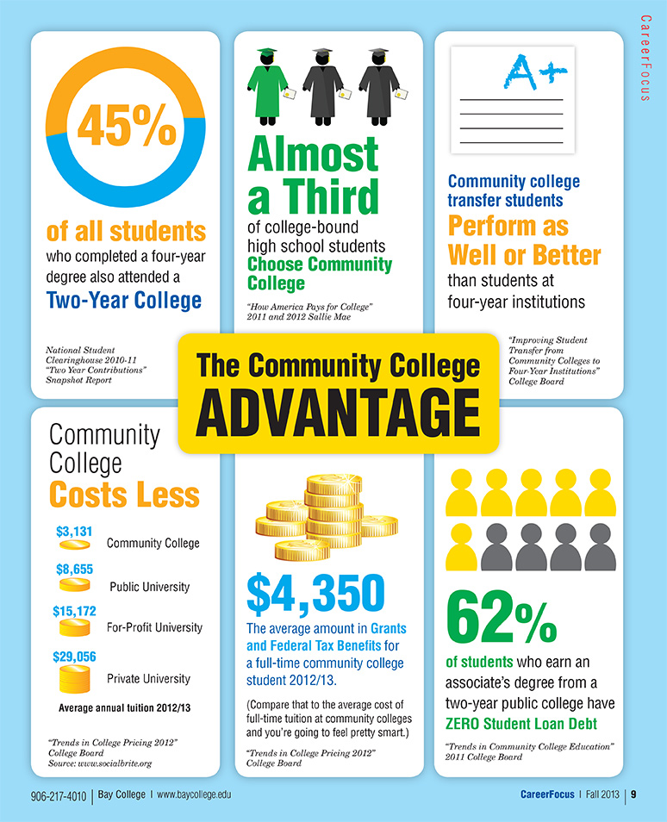
Community College
Community colleges are also known as “junior colleges” or “two-year colleges”. Instead of earning a bachelor’s degree after four years, students at community college can earn an associates degree in just two years.
Community college takes half the time to earn a diploma is because it usually only offer the general education requirements taken by all college students.
After taking classes at a community college students have the option to proceed to a college or university to pursue a bachelor’s degree.
If you think you don’t need one and have intentions to enter the workforce after attending community college you may use your associates degree and enter the workforce.

Slide 7
Colleges & Universities
This is the most popular choice for post-secondary education!
College and universities also provide post-graduate degrees.
Master’s Degrees
Specialists Degrees
Doctoral Degrees
Ex). graduate school, law school, medical school, dental school, and business school.
Another thing to consider when exploring different colleges and universities is whether they are public or private institutions.
Public institutions are state funded
Private institutions are donor funded or not for profit institutions
The difference between attending a college and a university.
Four year colleges class sizes tend to be smaller than those of a university, which provides students with more personal attention and better access. Many times at universities graduate students are teaching classes rather than professors.

Slide 8
7 Tips for preparing for post-secondary success
Take your time when deciding what you want to do and where you want to end up.
This is an important tip as you want to be happy with whatever decision you make, and don’t let others try and make this decision for you.
Continue to challenge yourself!
Many times high school students will take easier coursework senior year of high school. Continue to challenge yourself as many of the advanced classes you’re taking will have a similar layout in college.
Organize and balance your time!
Keeping a planner is the best thing any student can do to stay on top of the commitments that they have. With the balance of school and personal life, you have to remember to take time for yourself as well.
Perfect your note taking skills.
In most cases when students get to college the world of handouts or note taking guides leave. Do some research on the different ways to take notes and find what works best for you.
Find good reading and study habits
Instructors assign a lot of reading material throughout the semester. Finding the perfect balance of reading is important now to train your brain on what is expected in college. Students should spend about 30 minutes a day reading.
Figure out what your bad habits are and break them.
In high school students get habits of not reading text and have to do quick searches online for material. This will not be the best solution as many times professors will ask for specific quotes or page numbers about different instances that are quoted in the text. Reading is important and if you have a bad habit of not reading thoroughly, it’s time to train yourself to break that habit now!
Practice discipline
Get into the mindset of not putting things off, this could be completing assignments, scheduling meetings, or checking emails. Another aspect of practicing discipline is holding yourself accountable for completed tasks.

Slide 9
Credits
https://tophat.com/glossary/p/postsecondary-education/#:~:text=Postsecondary%20Education%2C%20also%20known%20as,as%20trade%20and%20vocational%20schools.
https://www.census.gov/newsroom/press-releases/2020/educational-attainment.html
https://www.calvin.k12.ok.us/213674_3
https://www.througheducation.com/everything-you-need-to-know-about-getting-a-post-secondary-education/
https://cte.careertech.org/sites/default/files/Georgia_CTE_Factsheet_2017.pdf
https://baycollege.mycareerfocus.org/community-college-advantage-infographic/
https://www.ontariovirtualschool.ca/thinking-ahead-10-ways-to-prepare-for-post-secondary-today/
https://www.ereferencedesk.com/education/types-of-schools/
https://www.accreditedschoolsonline.org/vocational-trade-school/georgia/
http://www.goodchoicesgoodlife.org/choices-for-young-people/the-benefits-of-higher-education/#:~:text=For%20such%20people%2C%20post%2Dsecondary,people%20to%20seek%20higher%20education.

