Slide 1
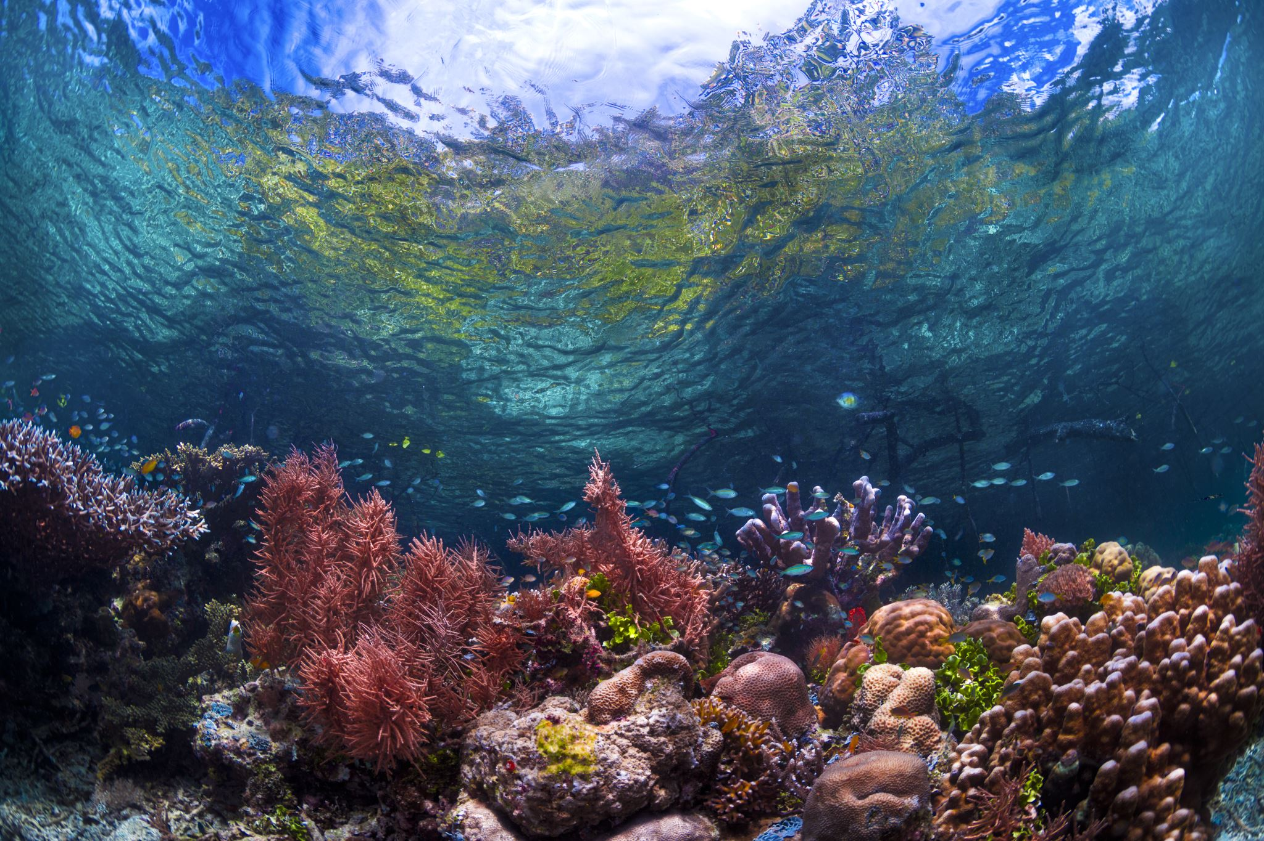
Protecting Coral Reefs
By Florida Duval Diplomats

Slide 2
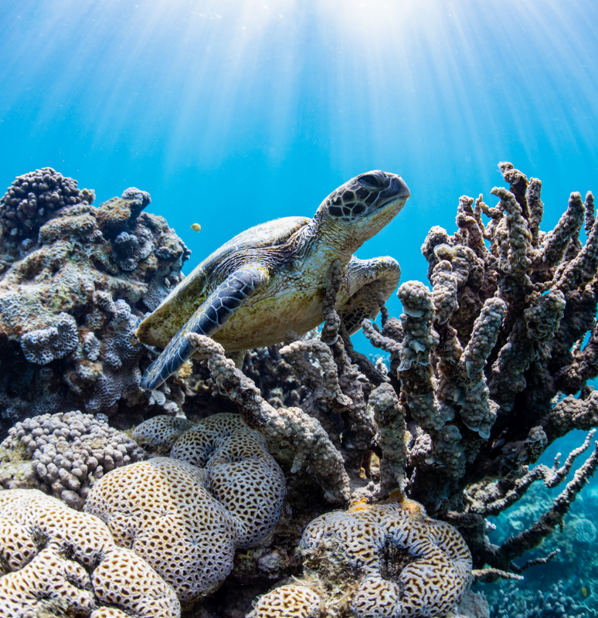
What Are Coral Reefs and Why Do They Matter?
Coral reefs are colossal underwater formations. These are made from the hard limestone exoskeletons of coral polyps. Coral reefs are some of the most diverse ecosystems in the world. In fact, due to the immense biodiversity in these habitats, coral reefs account for the "support [of] approximately 25 percent of all known marine species"(Florida Keys National Marine Sanctuary).

Slide 3
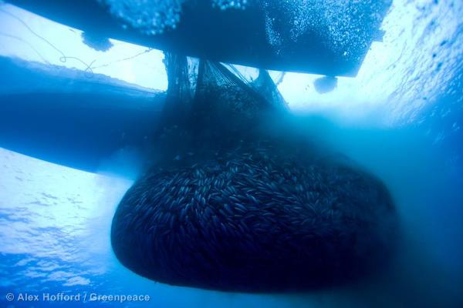
Dangers Coral Reefs Face
Overfishing
Harmful Fishing Methods
Coral Bleaching
Coral Harvesting
Pollution
Ocean Acidification

Slide 4
Physical Damage
Physical damage is the largest danger reefs face. Tourism in these beautiful areas brings coastal development, dredging, boat traffic, and recreational misuse. All of these physically disrupt reefs and can cause coral breaking off and dying.

Slide 5
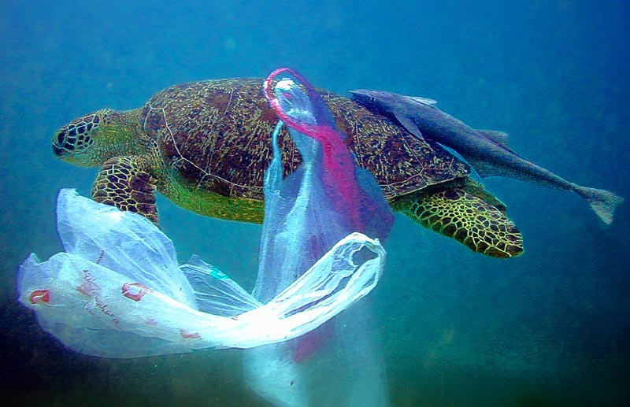
Pollution
Plastic is the largest category of ocean pollution with single use plastic bags, utensils, and bottles being so prevalent. But plastics aren't the only pollutants. Something anyone can personally do that would have large impacts on reefs is to use reef safe sunscreen. Oxybenzone and octinoxate are two very common chemicals found in sunscreens that are extremely toxic to coral and reefs in their entirety.

Slide 6
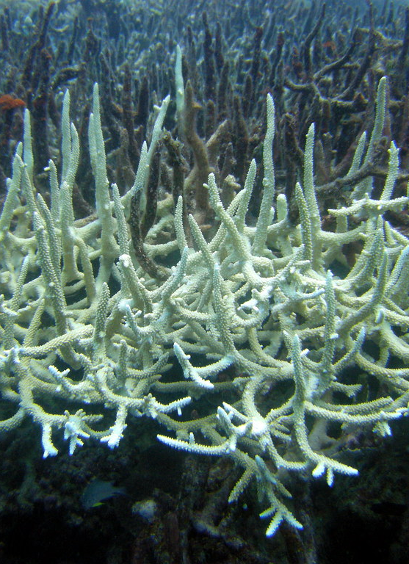
Climate Change
The ocean is responsible for absorbing about 25% of all CO2 emissions every year. When the ocean absorbs this much CO2 it changes the acidity. Right now this isn't a big deal because it just slows down coral growth. However in the future if acidity levels continue to rise at this rate it will eventually become toxic for fish to breathe and will kill a large majority of ocean wildlife. As greenhouse gasses and temperatures rise, the algae, the coral feed off of, die. This loss of a major food source causes bleaching.

Slide 7
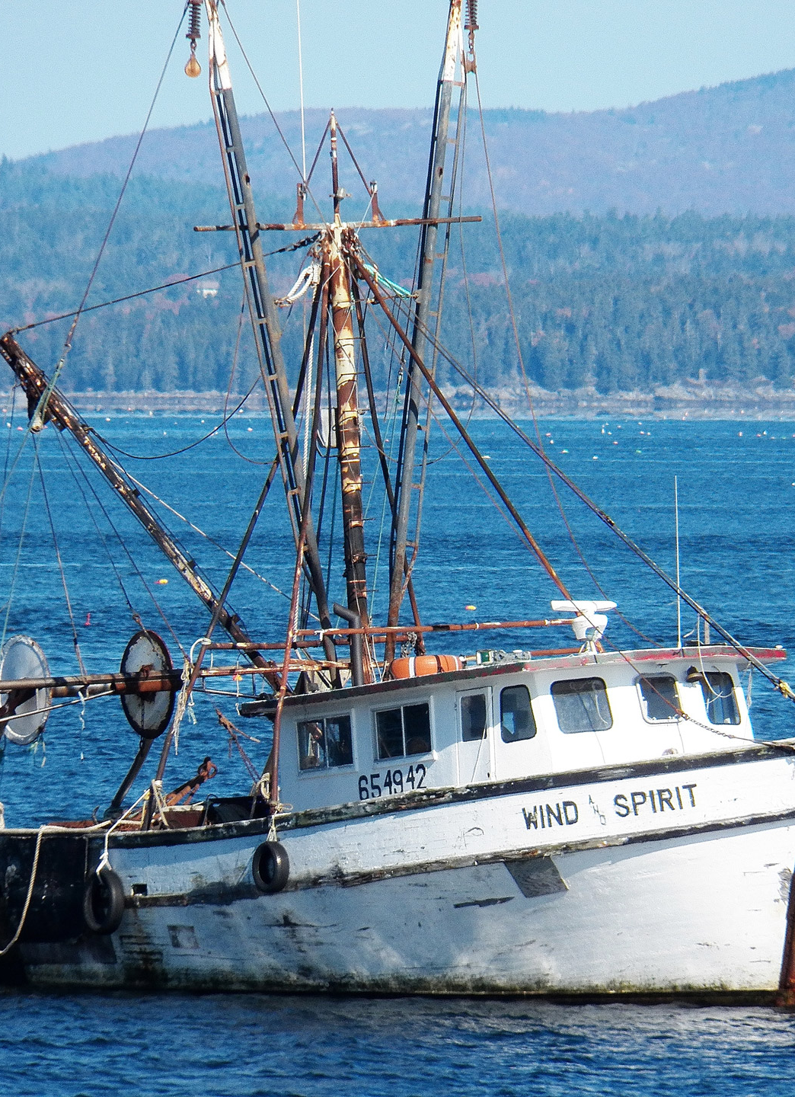
Harmful Fishing Methods
Fishing is very important for the economy and to keep fish populations stable. When done incorrectly, it can cause substantial damage. Trawling is a common method of fishing that is very harmful. Trawlers drag nets across the bottom of the seafloor to catch the marine life that lives on or near it. Trawling also damages the seafloor, uprooting vulnerable deep-sea corals, seagrass beds, and other habitats.

Slide 8
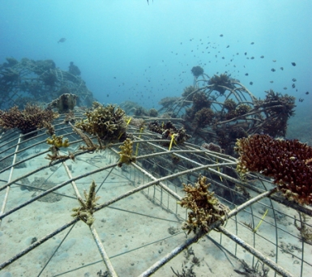
Protections Already in Place
Since coral reefs are so important and there are so many dangers to them; What are we doing to help?
Cloud Brightening is the spraying of microscopic sea particles into the sky using a turbine. The clouds ultimately cast a shadow over the coral and cool the water temperature during heatwaves, ultimately preventing coral bleaching
Biorock is a low voltage direct current that is run through steel and creates limestone. Coral fragments can be transferred to the Biorock structure and have a 50% greater chance of survival because this technology speeds up the process of coral growth.

Slide 9
References
https://www.epa.gov/coral-reefs/threats-coral-reefs
https://savethereef.org/about-reef-save-sunscreen.html
Status of and threats to coral reefs | ICRI (icriforum.org)
3.8: Destructive fishing methods - Biology LibreTexts
How does climate change affect coral reefs? (noaa.gov)
Coral Reefs - Oceans, Coasts & Seashores (U.S. National Park Service) (nps.gov)
Threats to Coral Reefs | US EPA
https://floridakeys.noaa.gov/corals/coralreef.html
https://tropicalmarinebio.pressbooks.com/chapter/how-technology-is-saving-the-world/
https://www.treehugger.com/creative-techniques-being-used-keep-coral-reefs-alive-4868013

