Slide 1
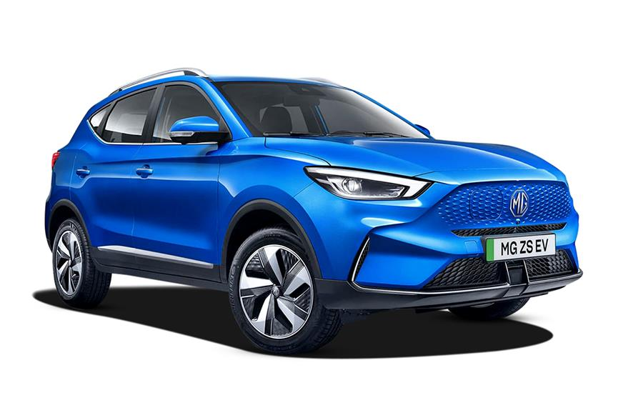
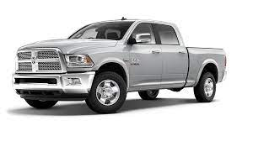
Buying Your First New
or Used Vehicle?
Maybe We Can Give You Some Tips
To Help With The Process?!

Slide 2
Bank Visitation
Prior to Your Bank Visit
Check your credit history to assist with loan options available
Find a trusted adult to accompany you to the bank
Have a basic idea of what car you would like to purchase and how much it will cost
Visit your Bank to check the following:
Amount of Loan you may qualify for at this bank?
Down Payment Amount Needed?
Affordable amount for you per month?
Insurance required for loan?
Option to pay off loan early?

Slide 3
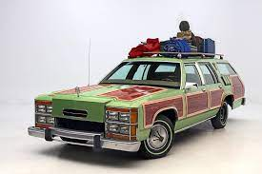
Choosing the Right Vehicle Part 1
One of the most important things while car shopping is making sure you get the right vehicle for all of your needs. These are the steps to go through to make sure you get the right vehicle for you.
Get an idea of the kind of vehicle you want. Some things to take into consideration: if it's for work, the weather where you live, if you have kids, how much space you need. There are all kinds of vehicles out there to fit your every need.
SUV
Hatchback
Crossover
Convertible
Sedan
Sports Cars
Coupe
Suburban
Pick-up
Diesel Pickup

Slide 4
Choosing the Right Vehicle Part 2
2. Set a Budget! Make sure you can afford the vehicle and get approved for a loan. Smaller vehicles are normally cheaper.
3. Make sure you Test Drive all kinds of makes and models so you know which one you like the best. (kind of seats, color, extra features.)
4. Finally look over all of the information you have gathered and make the best decision based of your needs, budget, and what you like.

Slide 5
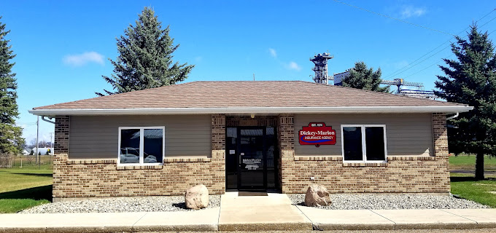
Car Insurance
Car insurance companies will help pay for damages to a car, depending on what kind of coverage you have.
In most states, liability coverage is required by law; Liability insurance covers damages that you caused to other property, vehicles, or even people.
Full coverage includes liability, comprehensive, and collision. Collision insurance pays for damages to your car in a crash. Comprehensive insurance pays for pretty much any other damage to your car that isn’t crashing into anything, like bad weather or theft.
On average, Full coverage costs about about $2000 annually while minimum coverage (minimum amount required to be street legal) usually costs about $600 annually.
Local Insurance Company
Dickey-Marion Insurance

Slide 6
Preparing to Buy the Vehicle at the Dealership
If you are planning on buying the vehicle at a dealership, some of the things you need to bring are
Driver’s License
Proof of Insurance
A list of questions you wish to have answered by the dealership and/or salesperson
Insurance comparisons for each type of vehicle under consideration if you have done the research
An idea of what you can afford to finance
The down payment amount you could afford
The monthly payment amount you could afford! (Do not share the previous two items with the salesperson-they can manipulate the payments to look good but the total cost may be much higher!!)

Slide 7
At The Dealership!!
Once at the dealership:
Take a few minutes to walk through the lot without the dealer
Identify vehicles of interest
Do not relate monthly payment amounts you would be comfortable with; focus on the “Purchase Price”
Watch out for add-ons and options not desired or needed!
Check Sticker information and compare
Always Test Drive the vehicle! (If you do not have a person with you with vehicle knowledge stop by a mechanic as you Test Drive!)
Take time away from dealer/dealership to evaluate possible purchase options
Visit multiple dealerships!!
Make a decision financially affordable for you!!
Feel Comfortable with “YOUR DECISION”!!
Remember the “Lemon Law” if something does not end up
being what is meant to be!!

Slide 8
Summarizing the Purchase of A New or Used Vehicle
Do Your Homework Ahead of Time
Check Your Credit Score for Loan Opportunity Information
Visit the Bank
Discover and Realize What You Can Afford
Compare Insurances by Vehicle Type and Company
Maybe Create a Checklist for the Dealership
Take a Close Look at the Sticker and Purchase Price
Test Drive and Visit a Mechanic
Check the Vehicle(s) History
Visit Numerous Dealers
Choose What You Want
REMEMBER THE “LEMON LAW”
End With A “Smile” on Your Face

Slide 9
Works Cited
Betterton,Rebecca.”7 Tips For Buying Your Teen’s First Car.” Bankrate, 01 Dec. 2022, https:/www.bankrate.com.
National Consumers League. “ConsumerMan Show: Buying a Car -with Herb Weisbaum.” National Consumers League, 19 Nov. 2014, Youtube.
NerdWallet. “Guide for the First Time Car Buyer.” NerdWallet, 2021, https://nerdwallet.com.
DriversEd.com “ Buying Your First Car: A Guide for Teens (and everyone else!)” DriversEd.com, 13 Jan. 2022,
https://driversed.com

