Slide 1
A youth initiative of the
National Consumers League and
YOUR STATE ORGANIZATION
www.lifesmarts.org
Notes:
Welcome. We are so glad to have the opportunity to tell you all about LifeSmarts—The Ultimate Consumer Challenge.

Slide 2
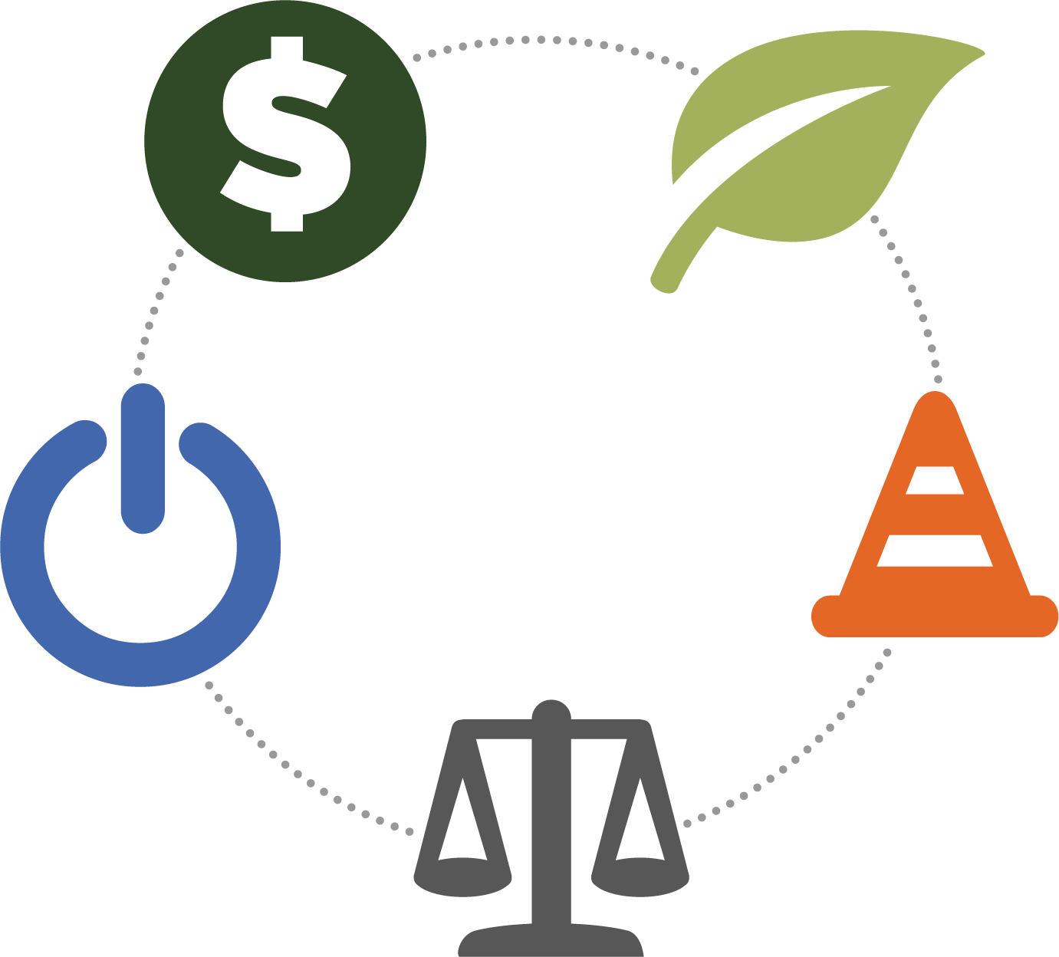
YOUR STATE LOGO HERE
Notes:
LifeSmarts—The Ultimate Consumer Challenge is a program sponsored by the National Consumers League.
For more than 20 years LifeSmarts has helped thousands of teens, across the United States become more educated and aware consumers.

Slide 3
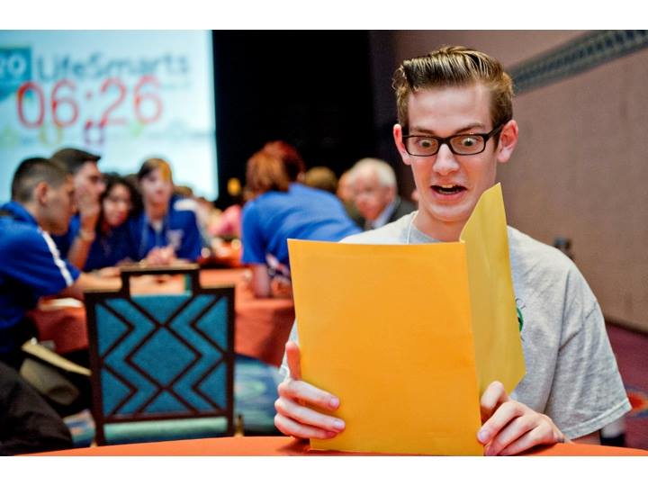
What is it?
LifeSmarts is:
a quiz bowl
competition
fun
challenging
a way to learn
things you need to know
Notes:
A game—actually several games
A competition—in person and online
Fun—especially if you are competing with friends
Challenging—you are not going to know all the answers
Learn things you know—life doesn’t have a textbook, but you don’t need to learn everything the hard way

Slide 4
WIIFM?*
*What’s in it for me?
Notes:
“What’s in it for me?” is a fair question.
LifeSmarts provides teens with essential knowledge and skills to survive and thrive in the marketplace.
LifeSmarts provides busy educators a “plug and play” program; once you become familiar with our website and resources, you can find activities, lessons and games that will fill a ten minute or a sixty minute time slot.
LifeSmarts is a program that students enjoy using.

Slide 5
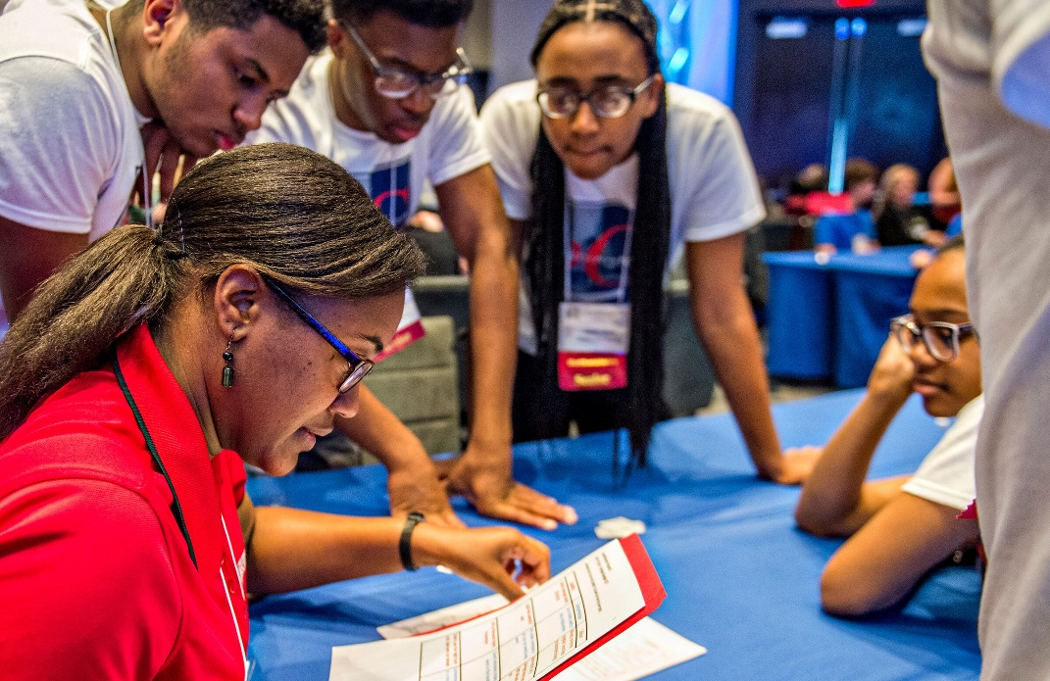
LifeSmarts is Consumer and Financial Literacy
Content, concept and vocabulary based
Real world application
Promotes thinking and discussion
Notes:
The program can be student or advisor directed,
it is flexible and you can choose to use as much or as little of the program as works in your situation.

Slide 6
We Tackle the Tough Issues
LifeSmarts goes in-depth on the issues teens face now and after graduation.
Environment
Personal Finance
Health & Safety
Consumer Rights
Technology & Workforce Preparation
Notes:
LifeSmarts teaches about information you find in the real world, as well as how to use limited resources wisely.
Topics covered in the program are key to family and community quality of life.
We help you understand how finance and consumer rights are linked and effect other topics and we help you learn to think critically about complex issues.

Slide 7
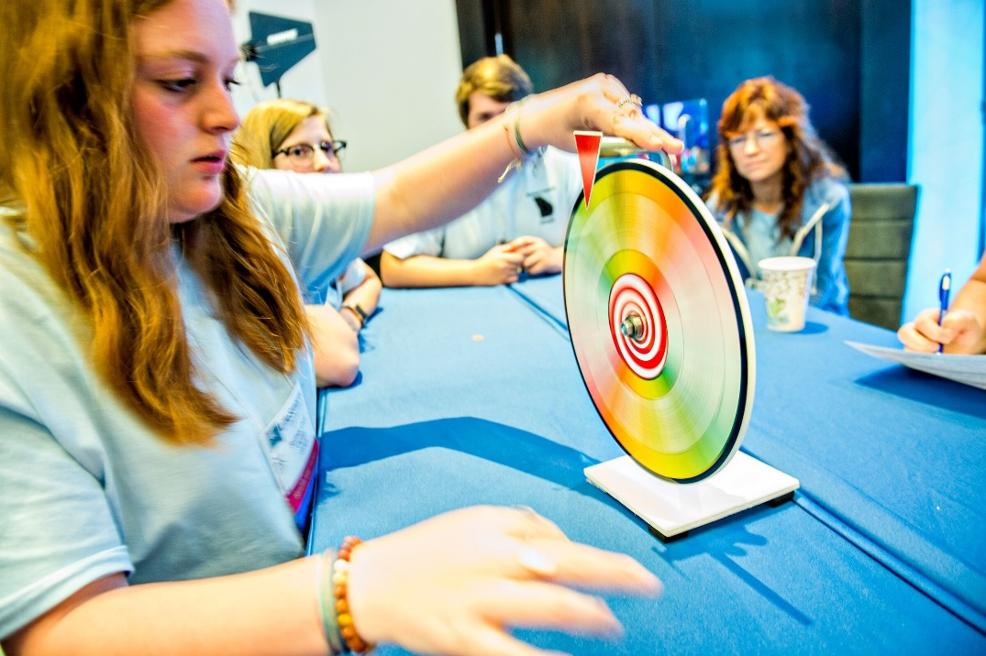
LifeSmarts Competition
Fun
Educational
Motivating competition
You can participate at
the local, state, and
national levels
Notes:
LifeSmarts Competition--The Ultimate Consumer Challenge is the heart of our program.
It is a fast paced and fun contest that prepares you today to be tomorrow’s informed, responsible citizens, consumers and employees.

Slide 8
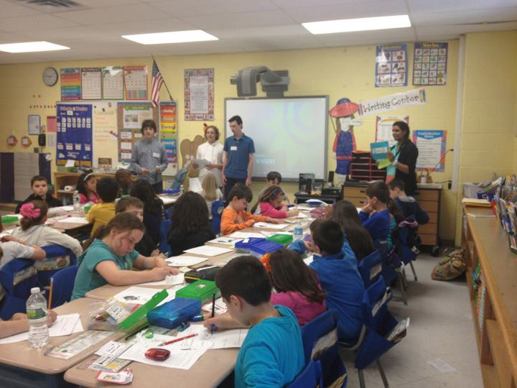
LifeSmarts in the Classroom
Content Vocabulary
Real-world learning
Competitive element
Life Skills
Notes:
Youth organizations such as 4-H, FBLA and FCCLA, as well as teachers in a variety of subject matter areas use the LifeSmarts platform to engage students in active learning.
The Program motivates teens and opens doors for them – and their families.
Educators tell us they use LifeSmarts because it gives their students the knowledge they need to be successful in life. It also aligns with what they are already teaching.
Teens tell us they use LifeSmarts to expand their understanding of the marketplace and it doesn’t hurt to know your team could qualify to attend the national competition.

Slide 9
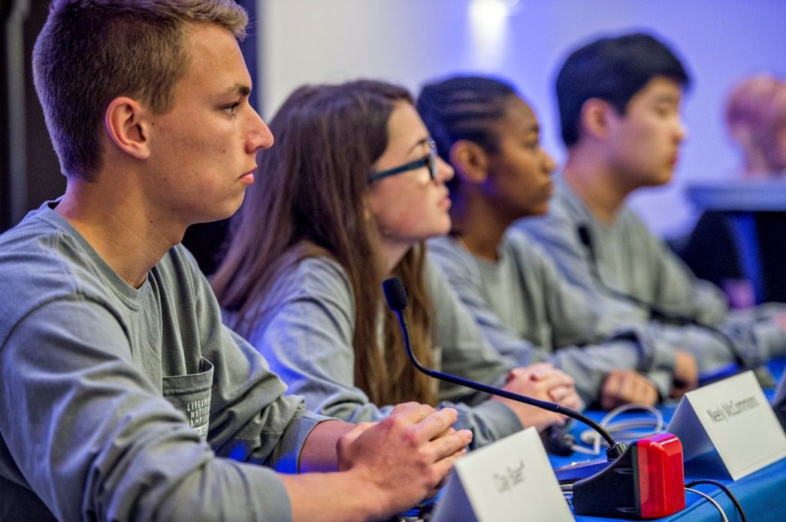
LifeSmarts is
Turn-Key and Versatile
Open to 6th through 12th
graders
Curriculum conforms to National Standards
Incorporates 21st Century Skills
Notes:
LifeSmarts is open to 6th through 12th graders.
The curriculum conforms to National Education Standards and also offers co-curricular fun.
Using game-show dynamics, the program adapts easily to any classroom, club, or community organization.

Slide 10
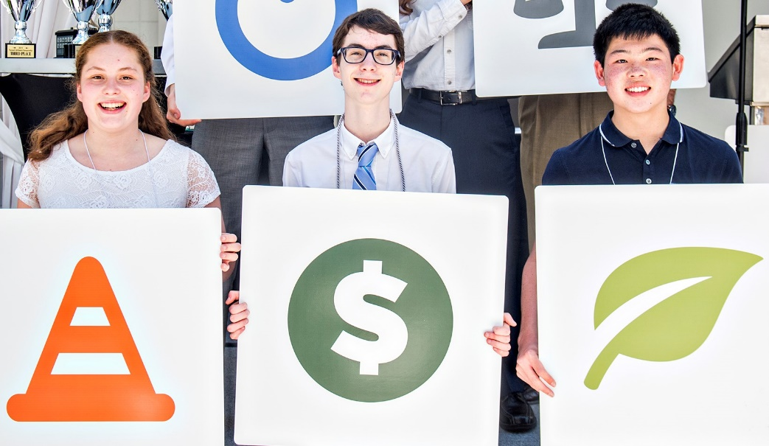
LifeSmarts is a
scholarship program
Students earn post-secondary scholarships in LifeSmarts:
Finalists at Nationals
OTC Medicine
Toyota Financial MLE
Notes:
LifeSmarts also connects students with opportunities to earn money for their post-secondary education. Some require players to qualify for an in-person competition, while others are open to anyone who completes the online qualifying quizzes.
In some states, participants could earn scholarships to specific colleges (add more information if you want)
At the National LifeSmarts Championship, all the players on the top eight teams will receive individual scholarships ranging from $250 to $1500. Individuals scoring the highest in the topic assessment each earn $500 scholarships.
Participants in Safety Smart, a service learning project sponsored by Underwriters Laboratories, are eligible for apply for $750 scholarships awarded in April. There are monthly cash prizes in Safety Smart as well, each presentation you make increases your chances of winning. You can find more information at www.lifesmarts.org.
As partners of Toyota Financial Services, LifeSmarts participants are eligible to apply for their “Making Life Easier” scholarships. Any student that is going to be in post-secondary education next year is eligible to apply for these 4-year scholarships – meaning former participants can apply as well. Again, more information at www.lifesmarts.org.

Slide 11
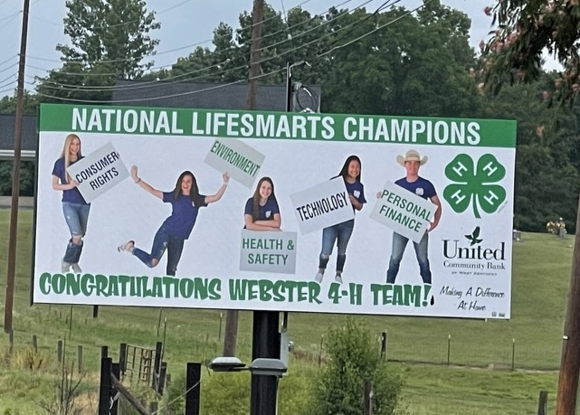
LifeSmarts Covers
all the Bases
Financial Literacy
Consumer Literacy
Citizenship & Leadership
Problem Solving
Teamwork
Critical thinking
Notes:
Our curriculum reinforces academic themes and is rigorous. We meet the needs of educators by infusing 21st Century Skills and a wide range of consumer and financial literacy topics.
Students practice skills in interpersonal communication, team-building, and in critical and creative thinking.

Slide 12
Content Literacy: LifeSmarts is a research-based program
“One of the most crucial services teachers can provide…is systematic instruction in important academic terms.”
Notes:
For educators and other professionals working with youth we used Robert Marzano’s research in academic-content vocabulary as a cornerstone of our educational materials.
LifeSmarts goes beyond memorizing definitions and helps students apply knowledge and think critically.

Slide 13
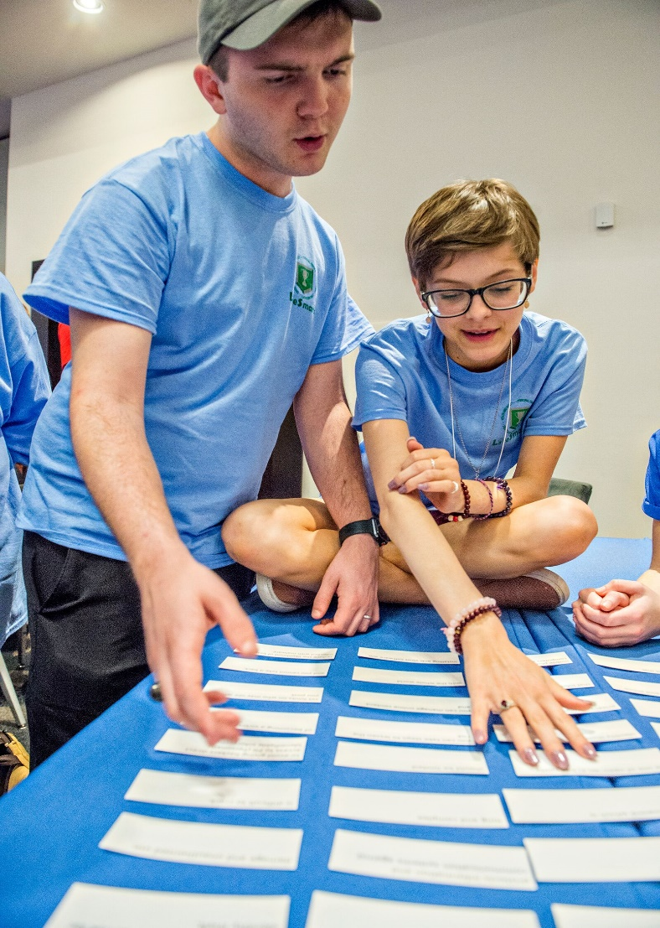
Repetition Repetition Repetition Repetition
We must use a word 6-14 times before it has lasting meaning that can be transferred.
Notes:
LifeSmarts helps you learn through repetition.
In order to “own” knowledge you need repeated use of the idea.

Slide 14
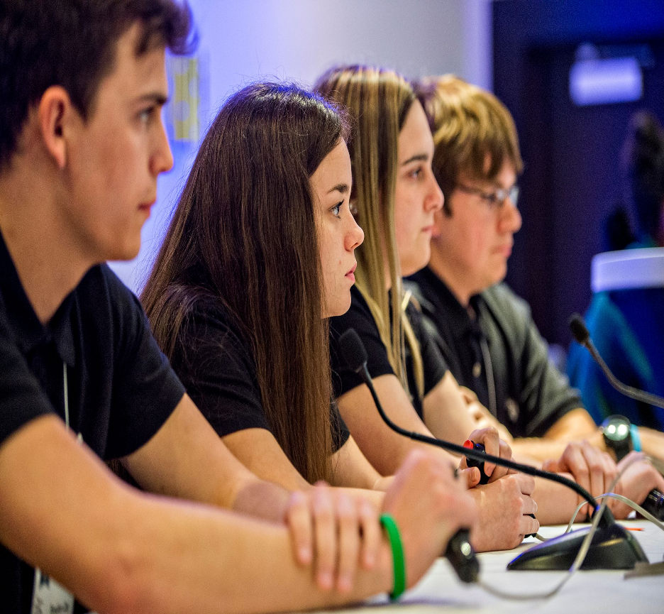
LifeSmarts Teamwork
Challenge a small group, a club, or a class
Reinforce financial literacy
Provide meaningful consumer information
Instill marketplace savvy and confidence
Notes:
We also know that effective learning can be teamwork.
LifeSmarts is first and foremost a Team activity.
Teens work as a team on activities and compete as a team.

Slide 15
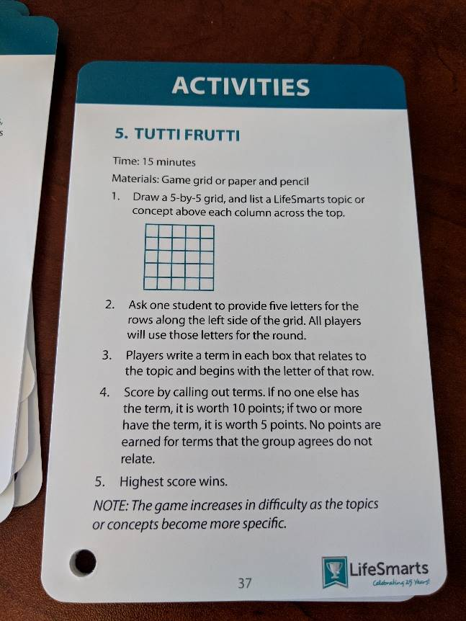
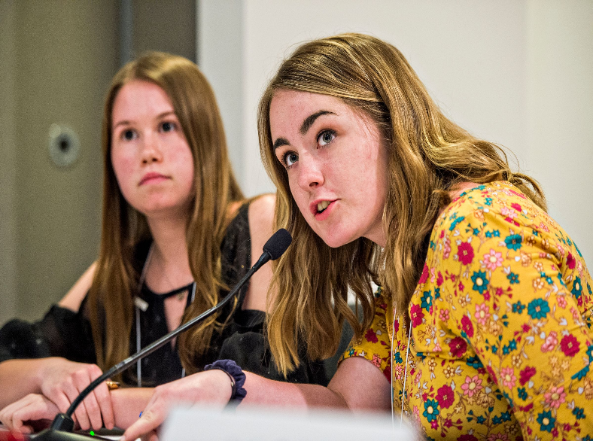
LifeSmarts Resources
Resource Pages
Online Practice Quizzes
LifeSmarts in a Box
TeamSmarts
LifeSmarts U
LifeSmarts Calendar & Vocabulary
Weekly Vocabulary Quizzes
Quizlet, Kahoot, Flippity and more
Notes:
The LifeSmarts Website has a variety of educational tools for coaches and teachers.

Slide 16
Competition begins online @ lifesmarts.org
Daily Quizzes
Category Practice Quizzes
Vocabulary Quizzes
TeamSmarts
Notes:
The LifeSmarts Web site has many ways to compete.
Daily quizzes consist of five topic questions-many educators use daily quizzes to begin class.
Practice quizzes contain twenty questions that cover all the LifeSmarts topics.
If you like, you can select to work in one topic area and choose the level of difficulty of your practice quizzes.
Your coach can check your scores and the number of quizzes you have taken.

Slide 17
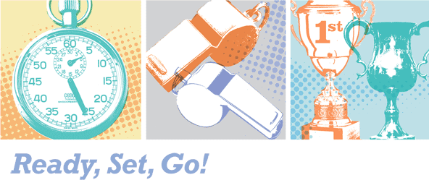
A chance to compete in a LifeSmarts topic for September - February
Form teams to compete
JV, Varsity, FBLA, FCCLA,
4-H, HOSA, and SkillsUSA Teams can earn cash awards
Classes or groups of students can compete within a school or organization
Notes:
TeamSmarts Competition is a monthly contest September - February. The competition consists of 100 multiple choice questions and a forty minute. Teams are scored for speed and accuracy. The competition is open for the entire month and closes on the last day of the month at midnight EST. TeamSmarts is also a great way to train for LifeSmarts competition.

Slide 18
LifeSmarts U
Health and Safety
Personal Finance
Consumer Rights &
Responsibilities
The Environment
Technology &
Workforce Preparation
Notes:
LifeSmarts U is a virtual classroom that provides students and educators with activities, PowerPoint Presentations and other resources.
For example, we go in-depth to show how to recognize the warning signs of fraud so teens can avoid the costly pitfalls.
Basic financial literacy lessons include topics such as: Decision Making, Making Money, Budgeting and Banking Services

Slide 19
LifeSmarts is Open 24/7/365
LifeSmarts U lessons include:
Vocabulary
List
Flash Cards
Lesson Plan
Activities
PowerPoint or Video
Student Activities and Answer Keys
Student Quizzes
And more
Notes:
Each LifeSmarts U lesson also includes: an article, FAQs, fast facts, resources, an online game, glossary terms, and practice questions.
These lessons are designed so that students may use portions independently or teachers can use for make-up and credit retrieval assignments.

Slide 20
Partnership with FBLA
Compete in the FBLA LifeSmarts Challenge
Compete in the FBLA TeamSmarts Challenges for cash awards
FBLA teams can earn a Wild Card bid to compete in the National LifeSmarts Championship
FBLA teams can compete in their State LifeSmarts Championship and more!
Notes:
Through partnership between LifeSmarts and FBLA student leadership teams have the opportunity to earn monthly cash awards in TeamSmarts, compete to represent FBLA at the National LifeSmarts Championship, and participate in the FBLA LifeSmarts Competitive event (Online and at the FBLA National Leadership Conference)
One FBLA team will earn $100 each month from September – January. Teams may only win once.

Slide 21
Partnership with FCCLA
Compete in the FCCLA/LifeSmarts Knowledge Bowl
Compete in FCCLA TeamSmarts Challenges for cash prizes
Earn FCCLA Wild Card bid to compete in National LifeSmarts Championship
Compete in State LifeSmarts Championship and more!
Notes:
FCCLA Chapters also have the opportunity to earn cash awards in TeamSmarts and to compete to become the FCCLA Team at the National LifeSmarts Championship.
Many FCCLA Teams use TeamSmarts to train for the FCCLA Knowledge Bowl Competitions.

Slide 22
Partnership with 4-H
Compete in the 4-H LifeSmarts Challenge
Compete in the TeamSmarts Challenges for cash awards
4-H Varsity teams can earn a Wild Card bid to compete in the National LifeSmarts Championship
4-H teams can compete in their State LifeSmarts Championship and more!

Slide 23
Competition runs September – April
Online State Competitions run from September through January
In-Person State Competitions are held in January, February or early March
National Championship:
April 21-24, 2022!
Contact Your
State Coordinator
Name
Organization
Email Address
Or phone #
Notes:
LifeSmarts mirrors the school year and culminates each year with the National Championship in April.

Slide 24
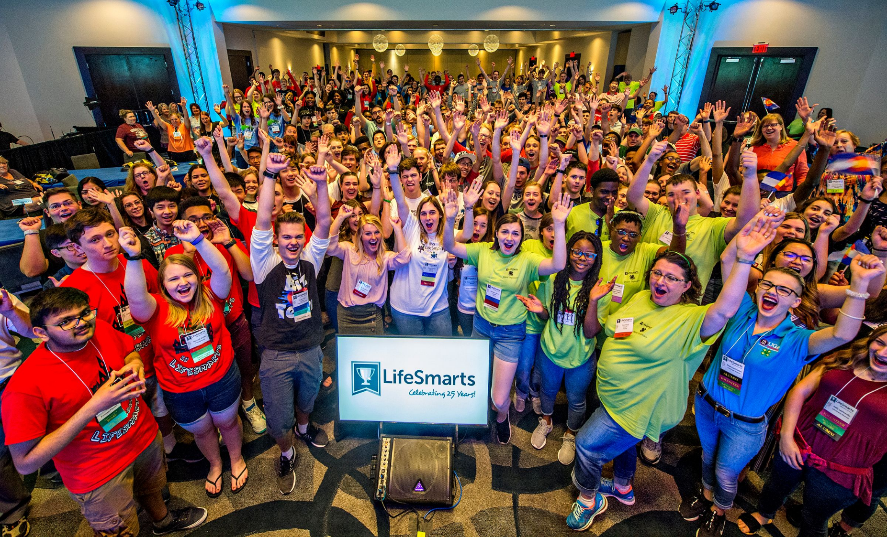
Questions?

