Slide 1
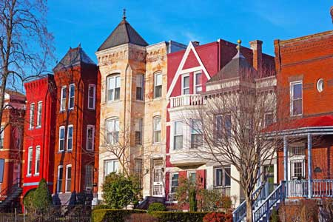
Apartment Safety & Security 101
Staying safe and secure when moving away from home for the first time.

Slide 2
2
2
LifeSmarts is a program of the National Consumers League

Slide 3
Checking out the apartment
Before signing a rental agreement, evaluate prospective apartments for safety and security.
Notes:
Renters assume responsibility for their own safety and security and also some responsibility for the apartment building where they live.

Slide 4
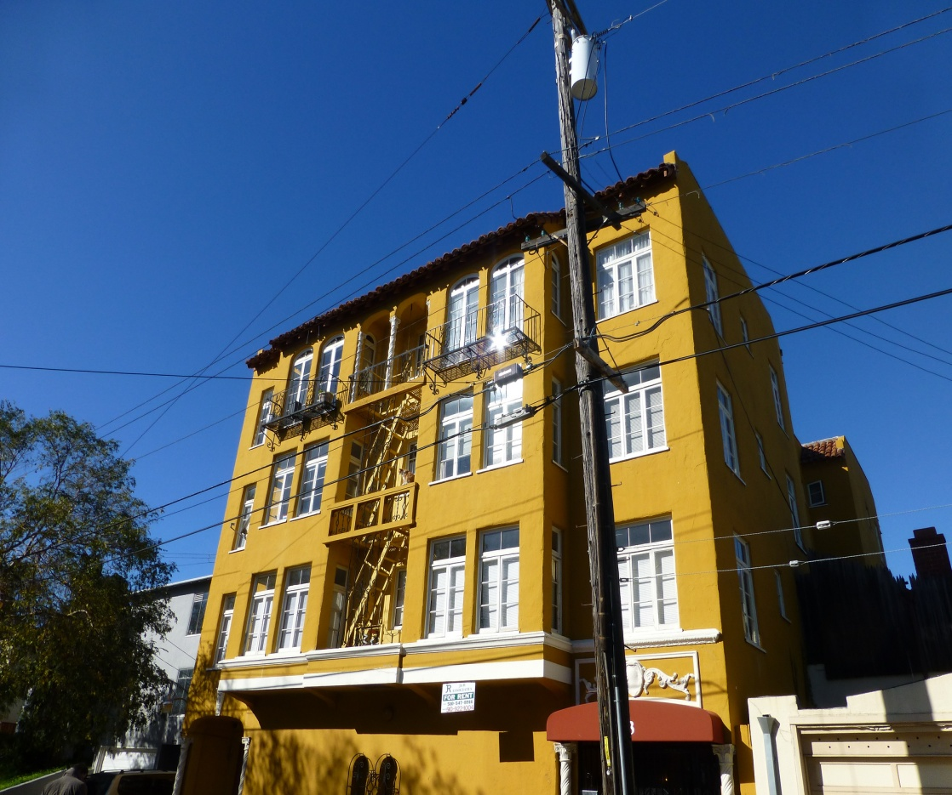
Security
Check the security of the surrounding area, the apartment building, and the apartment.
Notes:
There are many ways the landlord can make the property secure, it is handy to use a checklist when comparing potential apartments and their security features.

Slide 5
entrances
Inspect security lighting.
Look for streetlights and how the parking area is illuminated at night.
Make sure there is adequate lighting at all the entrances.
Notes:
Is a key needed to gain entrance to the building?

Slide 6
common areas
Inspect common spaces such as the laundry room, trash and recycling bins for adequate lighting and security.
Notes:
Is the laundry room locked, secure from theft?

Slide 7
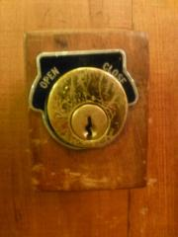
locks
Examine the door locks
Deadbolt locks are the most secure.
Check that the windows lock and that there is a security bar on all sliding glass doors.
Notes:
Windows should open easily if they are part of the fire escape plan.

Slide 8
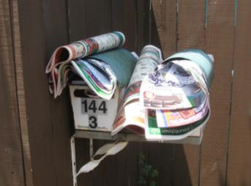
mail & package delivery
The mail and package delivery area should be secure.
Peepholes in apartment doors provide additional security.
Notes:
A last name is enough identification on the mailbox, avoid using a full name.

Slide 9
cameras
Look for security cameras and ask the landlord if they are operational.
Notes:
Where and how long are the security camera tapes kept? Should an incident occur, how can a renter get access to the film?

Slide 10
crime check
Before signing a rental agreement, contact local law enforcement and ask about the safety of the location and the crime rate there.
Also, check into reported crime at online sites like CrimeReport.com.

Slide 11
night and day
The perfect apartment may not be so perfect after the sun goes down. Before signing on the dotted line, complete a night time check of the neighborhood, the outside lighting, entrances, and parking.

Slide 12
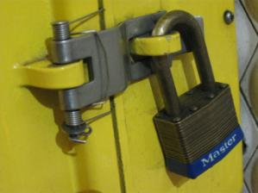
storage
If there is storage space outside the apartment, check to ensure it is secure, well lit, and weatherproof.
Notes:
Bike racks should be well lit and in plain view of the apartment building.

Slide 13
public transportation
Locate the nearest public transportation stop. It should be a safe and reasonable walk at night.
Notes:
Check on bus routes that use that stop and the frequency of buses runs.

Slide 14
Safety
Use your knowledge about safety to determine if the apartment you are considering meets basic safety standards.

Slide 15
5 minutes or less
Modern buildings reach the flashover point rapidly. Know that in case of fire, there is very little time to exit.
Notes:
When the fire temperature reaches the ignition point of the materials in the area, spontaneous combustion occurs. This is called flashover and it is deadly. Modern building materials and furnishings frequently reach flashover in 3 to 4 minutes.

Slide 16
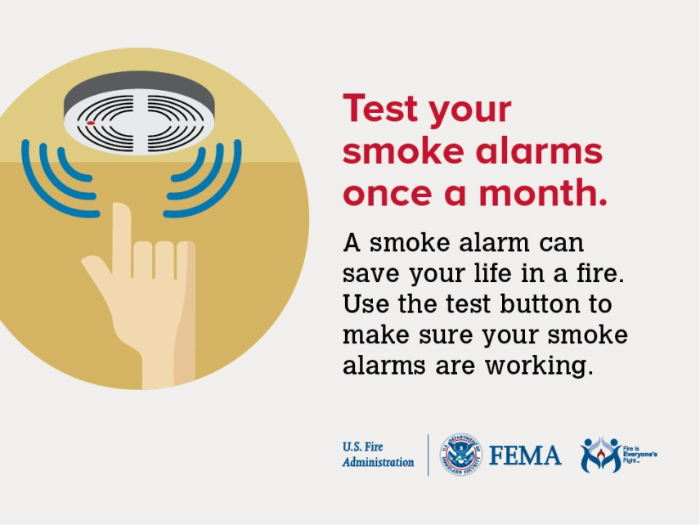
prevention
Every apartment should have operational smoke detectors, carbon monoxide detectors, and a fire extinguisher.
Notes:
Smoke and carbon monoxide detectors should be located in or close to the bedrooms. The fire extinguisher should be placed close to an exit.
Ask about the building’s fire safety plan and alarm system. Tenants should remember to test both smoke and carbon monoxide detectors once a month.

Slide 17
detection
There are two types of technology used in residential fire alarms: ionization and photoelectric.
Notes:
Ionization detectors are more sensitive to the flaming stage of a fire, while photoelectric react more quickly to smoldering fire. Each floor of your residence should have a fire alarm. In most fire deaths, it is the toxic smoke that is the killer.

Slide 18
carbon monoxide alarms
CO kills. It is created when fuels such as gasoline, wood, coal, natural gas or propane burn incompletely.
Notes:
Carbon monoxide is known as the “invisible killer.” It is an odorless and colorless gas.

Slide 19
responsibility
It is a tenant’s responsibility to know and follow the apartment building’s security rules and fire safety plan.
Notes:
Look for the fire safety notices and planned escape routes in the building. Know and practice an escape plan.

Slide 20
EDITH
EDITH stands for exit drills in the home. Know how to exit your apartment in the shortest time possible.
Plan two ways to exit the building and establish a meeting place outdoors with roommates and friends from the building.

Slide 21
emergency exit plan
Inside the apartment, plan at least two ways out of every room.
Windows, rope ladders, and exterior fire escapes are possible exits.
Notes:
Remember, an elevator is NEVER an acceptable emergency exit.

Slide 22
exits
Building exit doors should open outward, be unblocked and always unlocked.
Notes:
Exit signs in the building hallways should be lighted.

Slide 23
“get low and go”
Feel the door; if the door is hot, don’t open it. Use your alternate exit.
Leave immediately, closing doors behind, and knock on other doors as you exit.
If you must escape through smoke, crawl low under the smoke keeping your mouth covered.
Notes:
Room temperatures in a fire can be 100 degrees at floor level and rise to 600 degrees at eye level. Inhaling this super-hot air will scorch your lungs.

Slide 24
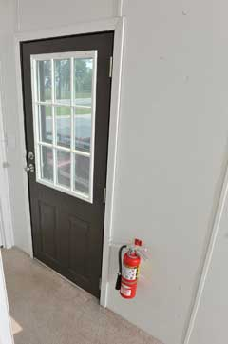
ABC fire extinguisher
An ABC (multipurpose) fire extinguisher should be installed close to an exit.
Notes:
Use a fire extinguisher only when a fire is contained in a small area and not growing.

Slide 25
PASS
Pull the pin
Aim low at the base of the fire
Squeeze the lever slowly
Sweep the nozzle from side to side
Notes:
The acronym PASS is a reminder of how to use a fire extinguisher. A fire extinguisher should only be used on fires that are contained.

Slide 26
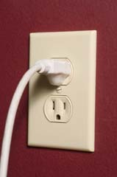
electrical outlets
Check for adequate electrical outlets in each room.
This helps avoid the use of extension cords and overloading circuits.
Notes:
Major appliances should never be operated with extension cords.

Slide 27
electrical panel
Know where and how to turn off the electricity. Check that the circuit breakers are clearly labeled.
Notes:
Also, check where and how to turn off the apartment’s water and gas.

Slide 28
most common fire starters
Cooking, candles, and smoking cause most apartment fires.
Notes:
Fire prevention includes never leaving cooking or candles unattended.

Slide 29
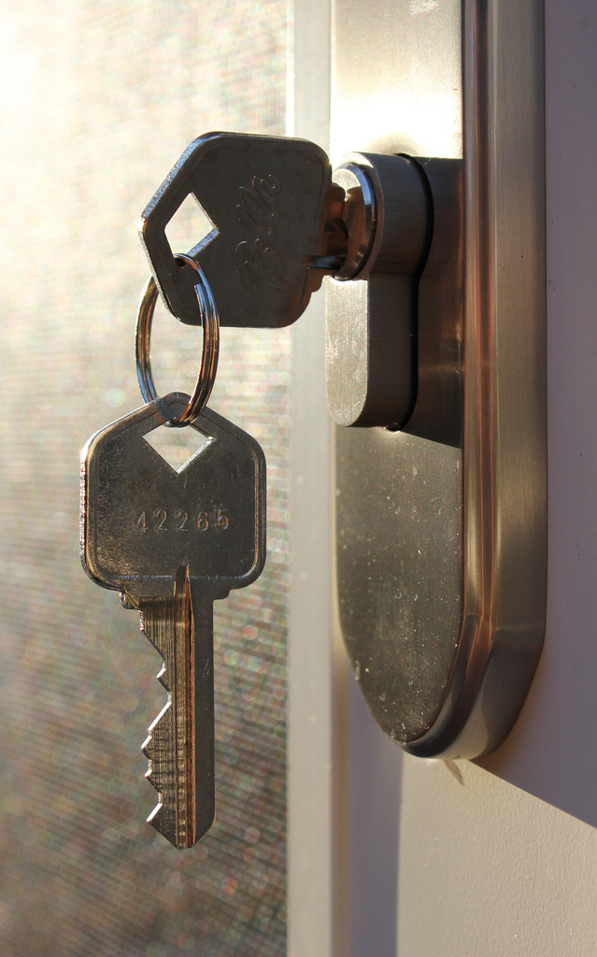
ALSO
A few additional helpful hints for first time renters.

Slide 30
renters insurance
You need it! The property owner’s insurance does not cover personal property or liability.
Notes:
Renters insurance is not expensive and it protects the tenant in case of theft or for liability when others are injured on your rented property.

Slide 31
noise
Ask management about the rules concerning noise, quiet hours, guests, and parties. Be sure you can live with those rules before you sign a rental agreement.
Notes:
It is important to be a good neighbor and to be considerate of neighbors’ needs for sleep or quiet. It is also good to know the rules about guests – will you be comfortable living in a building that has strangers coming and going 24/7?

Slide 32
management
Keep the name and phone number of the apartment manager handy. Know whom to call for electrical and plumbing repairs and emergencies.
Notes:
Discuss with management the processes for normal repairs and for emergencies. Keep emergency numbers in a place where they are easy to access.

Slide 33
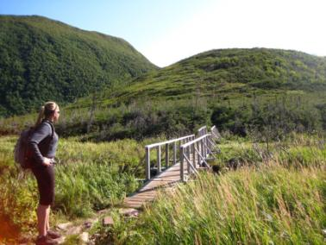
social media
Never reveal travel or recreation plans on social media. Wait and recount adventures when back home.
Notes:
Don’t invite thieves by posting travel or entertainment plans online. Broadcasting when you will be away from home is not security smart.

Slide 34
home sweet home
Knowledge and advance planning can help keep you safe and secure.

Slide 35
LifeSmarts
Learn it. Live it.
An educational program teaching teens and tweens important real-life knowledge
A competition – students compete online and in-person
A teaching toolbox. Check out our resources
An opportunity for students to gain leadership skills, and fulfill community service requirements
A partner with national groups such as FBLA and FCCLA
LifeSmarts is:
Visit LifeSmarts at www.lifesmarts.org

