Slide 1
WAY OR NO WAY
What do you really know about how Americans spend and save their money?

Slide 2
1-Way or No Way?
Only twenty-five percent of Americans report they “always” or “sometimes” worry about money.

Slide 3
1-NO WAY
Over 55% of Americans report they worry about money.
— USA Today

Slide 4
2-Way or No Way?
A recent survey of parents of high school students revealed that ninety percent of parents agree that their teenagers think “money grows on trees.”

Slide 5
2-NO WAY
64% of teens report being grateful for what they have and over 55% report appreciating their parents’ hard work.
Many teenagers are in the work force and understand that money and hard work go together.
2011 Charles Schwab Teens & Money Survey

Slide 6
3-Way or No Way?
A national survey revealed the average high school couple spends over one thousand dollars on prom.

Slide 7
3-WAY
The average family of a high school student going to prom spends
between $700-$1200.
That means a couple spends between $1400 and $2400.
2013 VISA-Prom Spending Survey
Notes:
The Visa survey also found that parents are planning to pay for 59% of prom costs, while their
teens are covering the remaining 41%.

Slide 8
4-Way or No Way?
When dreaming about which car to buy, the most important factor for teens was the style or “cool factor.”

Slide 9
4-WAY
The most important factor for parents was safety and reliability.
Behavioral economists tell us that our buying decisions are not always rational, but do follow patterns.
— autoextra.com

Slide 10
5-Way or No Way?
Workers with high school diplomas earn, on average, $260,000 more over their working life than workers who have not graduated from high school.

Slide 11
5-WAY
In fact, high school dropouts cost society money. They are often the consumers of welfare and public health service. It is estimated that dropouts cost society more than $500,000 over their lifetime.
Levin-CNBC 2012
Notes:
7000 high school students drop out of school every day.

Slide 12
6-Way or No Way?
Nineteen percent of bankruptcies are filed by people under the age of thirty-five.

Slide 13
6-WAY
The majority of teens believe there is greater pressure to have things, like computers, cell phones and clothes…than in previous generations.”
2011 Charles Schwab Teens & Money Survey
“There is no short cut to any place worth going.”
— Beverly Sills

Slide 14
7-Way or No Way?
Twenty-one percent of American’s say they are not saving enough, while over seventy-five percent feel their saving level is adequate.
“Now Mama said, “There is only so much fortune a man really needs, and the rest is just for showing off.’”
— Forrest Gump

Slide 15
7-NO WAY
Reverse those percentages and you have it right. Over 75% of Americans think they are not saving enough and 21% think they have an adequate savings plan.
29% of workers in one survey reported having less than $1000 in savings.
2013-Employee Benefit Research Institute

Slide 16
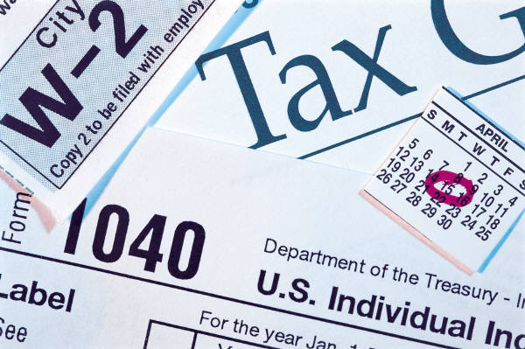
8-Way or No Way?
Research shows only eleven percent of Americans have an income of $100,000 or more per year.

Slide 17
8-WAY
While movies and television present the lifestyles of the rich and famous, most Americans are not wealthy.
“Whoever said that money can’t buy happiness simply didn’t know where to go shopping.”
— Bo Derek
Notes:
Over 15% of the American population lives at or below the poverty threshold and ½ of Americans households have an income of $50,000 or less.

Slide 18
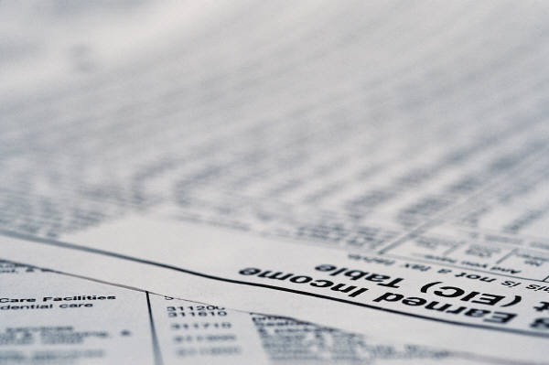
9-Way or No Way?
Middle class income for Americans is between $30,000 and $90,000 per year.

Slide 19
9-WAY
Even though this is a very wide range of income, Americans in this range consider themselves to be middle class.
— MIT Economist, Frank Levy

Slide 20
10-Way or No Way?
Over a lifetime of work, a college graduate earns about $400,000 more than a worker with only a high school diploma.

Slide 21
10-NO WAY
The gap in earning potential is much greater. A college graduate often earns $800,000 more during their lifetime than a high school graduate.
— collegeboard.com

Slide 22
11-Way or No Way?
The median household income in 2012 for all households in the United States was $51,000.

Slide 23
11-WAY
The median income is the center, one-half of the households are below $$51,000 and the other half are above that figure.
— U.S. Census
Notes:
The median income in Mississippi is less than $42,000 and over $65,000 for New Jersey.

Slide 24
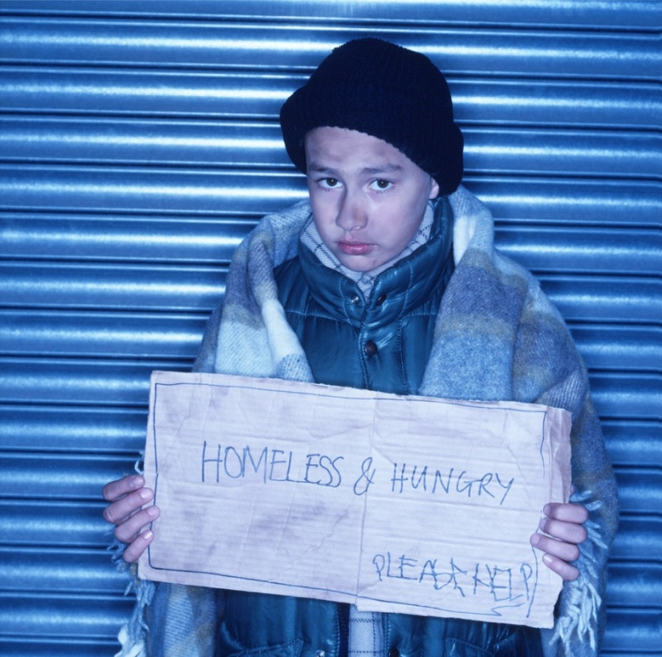
12-Way or No Way?
Approximately seven percent of Americans live in poverty.

Slide 25
12-NO WAY
15% of Americans, 46.2 million people, live below the level of poverty. The 2012 poverty level for a family of four, $23,050.

Slide 26
13-Way or No Way?
About 50 percent of Americans spend more money than they earn.
“Never spend money before you have it.”
— Thomas Jefferson

Slide 27
13-WAY
How does that work?
While 41 % of Americans save regularly 50% of Americans spend more than they make, using credit at least a few months out of the year.

Slide 28
14-Way or No Way?
Two thirds of college students graduate from college in debt for their education.

Slide 29
14-WAY
The average student debt for a four year degree is $25,250.
— projectonstudentdebt.org

Slide 30
15-Way or No Way?
Nearly one in three Americans -- 34 percent -- said that in some of the past 12 months, they paid only the minimum payment on their credit cards.

Slide 31
15-WAY
And for many families their credit card debt began with a wage earner losing their job or a medical emergency.
— FINRA Investor Education Foundation 2013

Slide 32
16-Way or No Way?
University administrators say they lose more students to credit card debt than to academic failure.

Slide 33
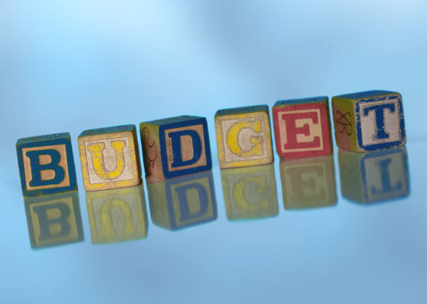
16-WAY
Only about 26% of college students report making and using a budget.
— CUNA

Slide 34
17-Way or No Way?
When making the minimum payment it takes eleven years to pay off a $2000 debt on a credit card with an 18.5 percent interest rate.

Slide 35
17-WAY
When you make the minimum payment it takes 11 years to pay off a $2000 balance and the interest charges will be almost $1900. Paying only the minimum payment almost doubles the cost.
— Sallie Mae

Slide 36
18-Way or No Way?
More than 54 percent of college freshmen carry a credit card.

Slide 37
18-WAY
Most teenagers access credit cards with help from their parents and often use them for school expenses or online purchases.

Slide 38
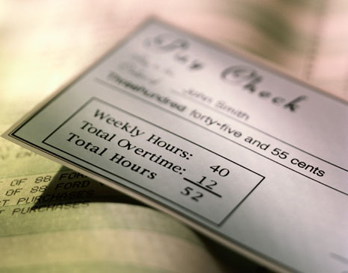
19-Way or No Way?
Seventy-seven percent of Americans occasionally live paycheck to paycheck.

Slide 39
19-WAY
Not only do Americans live paycheck to paycheck, but many have no money left after paying basic monthly expenses.
— 2012 CareerBuilder survey
Notes:
40% live paycheck to paycheck every month, while an additional 37% report living that way some months during the year

Slide 40
20-Way or No Way?
There are more payday lending stores in the United States than McDonalds and Starbuck stores combined.

Slide 41
20-WAY
12 million Americans used a payday lender in 2010.
— Pew Charitable Trust, 2012

Slide 42
21-Way or No Way?
The annual percentage rate (APR) on a fourteen day payday loan ranges from 100 to 150 percent.
Notes:
Cash Advance

Slide 43
21-NO WAY
The interest rate on most payday loans ranges from 390% to 780%.
This is sometimes termed “predatory” lending.
— paydayloaninfo.org

Slide 44
22-Way or No Way?
The United States Department of Agriculture estimates that feeding a family of four at home for one month, using what they term the “low cost” plan, would cost $479.

Slide 45
22-NO WAY
That is the estimate for only two people, add two children under the age of eleven and the “low cost” is $828 per month.
But if you are on your own and are on “liberal” plan the USDA estimates your food expenses will be $362, and that is before you “dine out.”
— USDA Food Plans, 2013

Slide 46
23-Way or No Way?
Many experts agree that you should not worry about saving until you have financial security and want to buy your first home.

Slide 47
23-NO WAY
From your first paycheck you should PYF (pay yourself first) and begin to save for short and long terms goals.
Experts recommend that you save between 10% and 15 % of your income each month.
— choosetosave.org

Slide 48
24-Way or No Way?
Once you are on your own, you need about two months of income put away for emergencies or to pay living expenses should you lose your job or become ill.

Slide 49
24-NO WAY
You need to have a least 3-6 months living expenses in an emergency savings account and your do not spend unless unexpected circumstance demand it. Repay the account as soon as possible.
— consumeraction.org

Slide 50
25-Way or No Way?
The average worker works 113-130 days each year to pay taxes, if one hundred percent of their paycheck went to pay federal, state and local taxes and fees.

Slide 51
25-WAY
That means Americans will work nearly four months of the year, from January 1 through mid- April, before they have earned enough money to pay their yearly tax obligations at the federal, state and local levels.
Tax Freedom Day is the day that American tax payers have finished paying their tax burden for the year.
— Tax Foundation.org
Notes:
What benefits do teenagers receive from taxpayers being willing to “shoulder the this tax burden?”

